Slide 1

Macbeth
Year 10 and 11

Slide 2
English Subject Terminology
alliteration | Repeated sounds at the beginning of words. | The big blue balloon burst.
rhythm | A strong pattern to sounds and words, often created by rhyme or meter. | ‘Double, double toil and trouble; fire burn and cauldron bubble.’
rhyme | Words that rhyme have the same end sound. | cat/bat flew/through
meter | Meter is the rhythm of syllables in a line of verse or in a stanza of a poem. | ‘Two households, both alike in dignity/ In fair Verona, where we lay our scene.’ (Iambic pentameter – 10 syllables in a line following an unstressed/stressed pattern).
syllable | A single unit of sound within a word. When analysing poetry, we often count the syllables as beats in a word or sentence. | One syllable – cat Two syllables- rocket Three syllables - attention
metaphor | An expression, often found in literature, that describes a person or object by referring to something that is considered to have similar characteristics to that person or object. | The city is a jungle. The mind is an ocean.
simile | An expression comparing one thing to another, always including the words ‘as’ or ‘like’. | ‘She walks in beauty, like the night.’
imagery | The use of description to create an image in the reader’s mind. | The sunset was the most glorious they'd ever seen; the clouds were edged with pink and gold.
personification | The act of giving a human quality or characteristic to something which is not human. | Rita heard the last piece of pie calling her name. My alarm clock yelled at me to get out of bed.
enjambment | A continuation of a sentence or clause across a line break. | ‘A suspicion, a doubt, a jealousy/grew in my mind.’
onomatopoeia | Words that include sounds that are similar to the noises which the words describe. | Buzz, crack, whizz.

Slide 3
English Subject Terminology
tense | Indicates when an event being described takes place (past, present, future). | He ran/He runs/He will run.
person | The ‘person’ that we write in can make a piece of writing personal, direct, or detached. | First person – I, We Second Person – You Third Person – He/She/They/It
imperative verbs | Verbs of command, intended to express command. | ‘Stand up’, ‘Sit down’.
modal verbs | A verb that expresses necessity or possibility. | must/may/might/shall/should/ could/would/will/can/could
sibilance | The repetition of ‘s’ sounds. | ‘Sing a song of sixpence’.
anaphora | The repetition of a word or a phrase at the beginning of successive clauses. | ‘Half a league, half a league,/Half a league onward’.
rhetorical questions | Questions asked to the reader/listener which do not require an answer. They are designed to make the reader/listener think about their own personal response to the question. | How would you feel if this happened to you?
anecdote | A brief narrative, used to exemplify a point or idea. | John was missing his family after he moved across the country, but thanks to Facebook, he could stay connected.
juxtaposition | When two ideas are compared. | ‘It was the best of times, it was the worst of times, it was the age of wisdom, it was the age of foolishness…’
statistics | The use of numerical data to support an opinion. | 90% of people agreed that smoking should be banned.
opinion | A view or judgement formed about something, not necessarily based on fact or knowledge. | Italian food is the best.

Slide 4
English Subject Terminology
emotive language | Language that is used to evoke an emotional reaction. | An innocent bystander suffered facial injuries when the thug launched his glass across the bar.
triple (rule of three) | The use of three ideas or examples within a sentence to add emphasis to an idea. | Across the Commonwealth and around the world, we have seen heart-warming stories of people coming together to help others, be it through delivering food parcels and medicines, checking on neighbours, or converting businesses to help the relief effort.
synonym | A word or phrase that means exactly or nearly the same as another word or phrase in the same language | shut/close
antonym | A word opposite in meaning to another. | bad/good
hyperbole | Intentional exaggeration to draw attention to an idea of make a powerful point. | It was so cold, I saw polar bears wearing hats and jackets.
pathetic fallacy | A literary device wherein the author attributes human emotions and traits to nature or inanimate objects. | The leaves danced. The sullen clouds lurked above us.

Slide 5
Literacy Task
Why Study Macbeth?
Although Macbeth was written over 400 years ago, it has kept its appeal for today’s audiences. A brave Scottish general named Macbeth receives a prophecy from a trio of witches that one day he will become King of Scotland. Overtaken by ambition and pushed into action by his wife, Macbeth murders King Duncan and takes the Scottish throne for himself. He is then filled with guilt and paranoia. Macbeth is still relevant today as people can still be motivated by greed, ambition and jealousy just like in Shakespearean times, doing anything for money or power.
A key dramatic feature of Macbeth is the theme of the reality vs appearance, as Macbeth often wants to hide his dark and violent thoughts and actions by appearing like a good man to those around him, much like how anyone can mask who they truly are nowadays for their own gain. The play is an epic story about pride and the dangers of wanting too much, filled with characters who are entirely human and a focus on how cruel people can become, compared to those who show loyalty and a love of family.
Glossary:
prophecy – a prediction of what will happen in the future.
paranoia – uncalled for suspicion and mistrust of other people.
ambition – a strong desire to do or achieve something.
What have you learned about the play?
What is Macbeth driven to do wrong?
What does the play show is dangerous?
What are the characters in Macbeth like?
What are the main themes in the play?

Slide 6
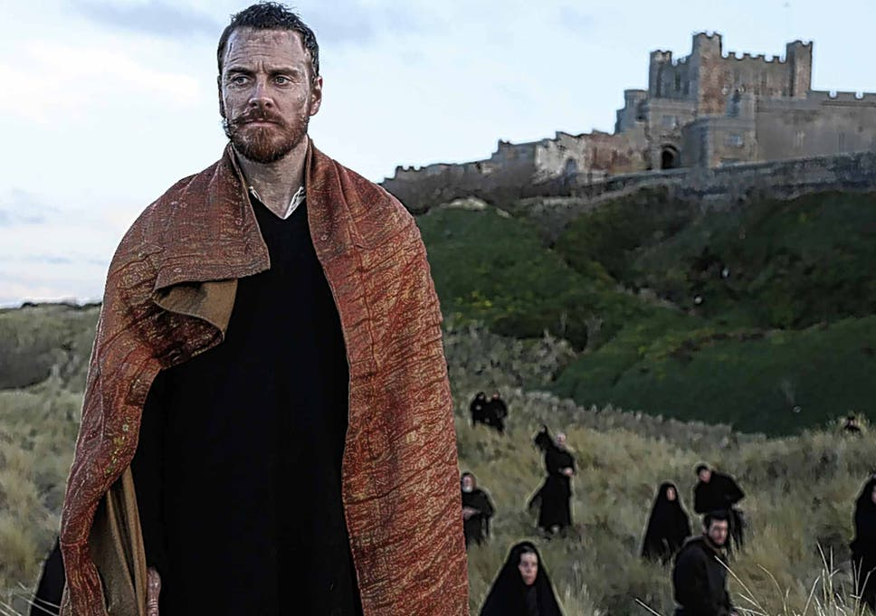
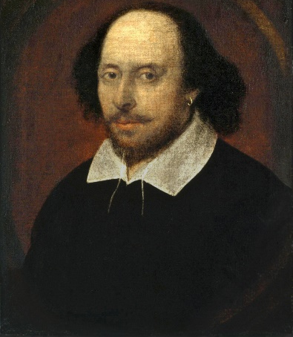
Practice 1- Context (William Shakespeare)
William Shakespeare, the writer of Macbeth, is believed to be the best British writer of all time. He writes about life, love, death, revenge, grief, jealousy, murder, magic and mystery.
Shakespeare was born into a family that was fairly poor. His father was a glove-maker and his mother worked as a nurse and later in a warehouse.
He grew up in Stratford-upon-Avon in Warwickshire.
His plays focus on characters' feelings and motives with a clever handling of light and dark, change of pace, and the weighing up of right and wrong.
The play reflects the consequences of regicide, one of the worst crimes possible at the time.
The play was written in 1606, but it’s set from the year 1040 to 1057.
Shakespeare composed Macbeth to please his new king, James I. Shakespeare’s acting company and the king had a good relationship.
The theme of bad versus good kingship (Macbeth vs King Duncan) would have been enjoyed at the royal court as the play ends badly for Macbeth as a result.
Glossary:
regicide – the crime of killing a king
Jacobean – a person alive during the reign of King James I.

Slide 7
What have I learned?
Secure the basics
What does William Shakespeare write about?
What did Shakespeare’s parents do?
Which city did he live in while growing up?
What do his plays focus on?
Master the topic
What is regicide?
When was the play set?
Why was Macbeth written?
Can you think of any similarities between the events of Macbeth and today’s attitudes towards royalty?

Slide 8
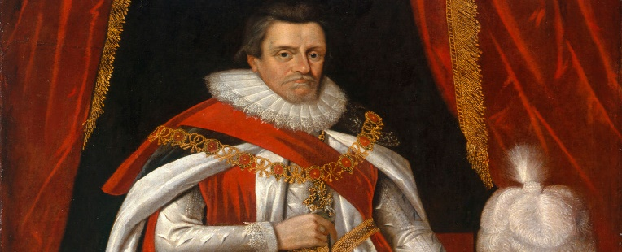
Practice 2- Context (Jacobean England)
Before King James came to power in England, William Shakespeare already had a relationship with the royal family. Shakespeare and his men performed his plays for Queen Elizabeth. The plays during this time period, known as the Elizabethan era, were more playful and light-hearted.
When Queen Elizabeth died, Shakespeare wanted to be sure that he and his men continued to work with the new king during the Jacobean era. 'Macbeth' was his way to gain favour with King James. This play also marked a shift in Shakespeare's work to darker and more tragic themes.
This was because Shakespeare's writings during the Jacobean era really reflected the uncertainty in England. When Queen Elizabeth died in 1603, she had no children and no nieces or nephews. Because of this, the throne was offered to King James of Scotland, a very distant cousin of Elizabeth I, and he then became King James I of England.
This was not an easy transition for the people of England. Since he was not an immediate family member of Queen Elizabeth, many other distant relatives challenged his placement and said they had a right to the throne.
King James lived in constant fear that someone would overthrow him, which often led him to violence. For example, when a plot to plant a bomb and kill King James and Parliament was discovered, King James publicly tortured and killed those involved.
This is what we know as ‘the Gunpowder Plot’ nowadays, where Guy Fawkes is burned at the stake.
Despite his paranoia, King James had a deep belief that he was supposed to be king. He believed that God chooses kings and that the throne was his fate. However, this did become one of the reasons that he ruled with fear. The people of England worried that if they questioned him, they were really questioning God.
Because of this, Jacobeans were made to believe in the king’s idea of "The Great Chain of Being". This was the idea that everyone was ordered by God into his right place, with the king at the top.

Slide 9




What have I learned?
Secure the basics
What were Shakespeare’s plays like in Elizabethan times?
How did they change in Jacobean times?
Why did he change his plays?
What did people think about King James I at first?
Master the topic
What led the king to violence?
What do we call the attack on King James I’s life nowadays?
What did the people of England worry about?
What is “The Great Chain of Being”?

Slide 10
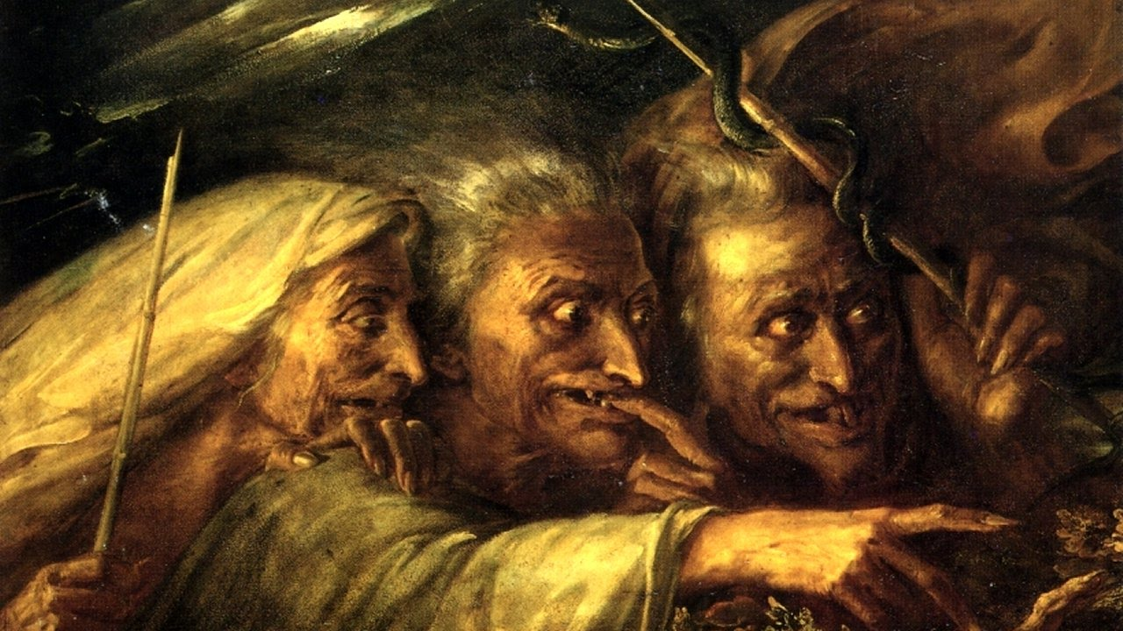
Practice 3 – Context (The Supernatural)
Glossary:
Supernatural – a force beyond scientific understanding or nature, like ghosts.
Deception – the act of not being truthful.
Cowardice – lack of bravery, being a coward.
In Shakespeare's time, the powers of evil were thought to be absolutely real.
To most people Hell was an actual place and the Devil a constant threat to their souls.
In particular there was a fascination with witches and witchcraft. Hundreds of innocent people (mostly women) were executed as suspected witches.
This interest came from the very top, led by King James I himself who published a book on the subject called Demonology.
When Shakespeare came to write his play, he knew that his audience would find the theme of evil and the supernatural very interesting indeed.
The Witches' predictions encourage Macbeth to think wicked thoughts and carry out evil deeds. As well as murder, Macbeth is also guilty of lying, deception, cowardice, as well as seeking out further contact with evil forces.
The Witches' appearance at the start of the play in the middle of a thunderstorm (apparently of their own creation) sets the tone for what is to follow. As well as predicting the future, controlling the weather and casting evil spells, they also discuss the wicked acts they carry out against ordinary men and women.
When King Duncan is killed, many strange things happen. These include strong winds, strange ghostly cries in the night, an owl screeching (thought to be a bad omen) and even an earthquake. The natural world has been disturbed and disrupted following the unnatural killing of a king.

Slide 11
What have I learned?
Secure the basics
What supernatural beings did people think were real in Jacobean England?
What were people fascinated in?
Where did this interest come from?
What did King James I write?
Master the topic
What do the witches cause Macbeth to do?
How do the witches appear at the beginning of the play?
What supernatural events happen when King Duncan is killed?
Why do all these unnatural things happen?

Slide 12
Practice 4 - Context (Gender Roles)
Glossary:
Domestic: Relating to what happens at home, in a household.
Dependent: Needing someone or something for support.
Even though there had just been unmarried woman on the throne in Jacobean England (Queen Elizabeth I died in 1603), the roles of women in society were very limited.
Most women were given education only if they were members of the nobility. Otherwise, they had to stay home and learn to run the household and become the housewife.
Education included knowledge of several languages, including Latin, Greek, Italian, and French. However, even upper class woman were not allowed to go to university and were only taught by tutors who visited them in their home.
Women were also allowed to write works of literature, providing the subject was suitable for women: mainly translations or religious works. Women were not allowed to act on the public stage or write for the public stage.
From birth, Jacobean Era women were taught how to govern a household and perform domestic duties so that when they married, their husbands would be proud. Childbearing was considered a great honour to women, as children were seen as blessings from God, and they took great pride in being mothers.
Women were seen as "the weaker sex", not just in terms of physical strength, but emotionally too. All throughout their life, the women of the Elizabethan times were made to become dependent on a male relative - father, brother, uncle, husband, or other.
Disobedience against men was seen as a crime against their religion.
The Jacobean family life for men was one of power. The men made the decisions and the women were expected to obey them. Men, especially in the upper classes, were expected to remain loyal to country and King (or Queen!), even if it meant resorting to violence. It was thought that men were inherently violent creatures that needed to be tamed. This stood in contrast to the calm, gentle nature that was expected of women.
Linking to character: When we first see Lady Macbeth she is already plotting Duncan’s murder, and she is stronger, more ruthless, and more ambitious than her husband. She seems fully aware of this and knows that she will have to push Macbeth into committing murder. At one point, she wishes that she were not a woman so that she could do it herself. This flips gender roles of the time and shocked audiences as a result.

Slide 13
What have I learned?
Secure the basics
What types of women were allowed to have an education in the Jacobean Era?
What were women not allowed to do?
Who did women have to depend on?
How did Jacobeans view women who were disobedient?
What responsibilities did women have?
Master the topic
What responsibilities did men have?
How were men and women mainly view as different in Jacobean England?
Why was this?

Slide 14
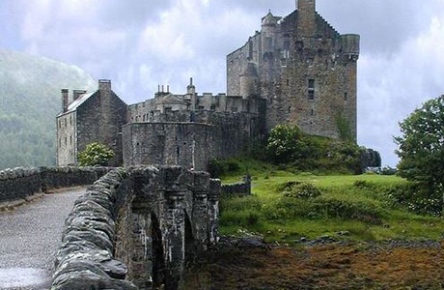
Practice 5- Context (Setting – 11th Century Scotland)
Macbeth is set during the 11th century in Scotland, in the northernmost region of what is now the United Kingdom. At the time the play is set, Scotland was a separate country, although it being close to England led to many struggles over who would rule the area.
Due to its far northern location, Scotland is often dark, dreary, and damp – the perfect setting for a play about evil deeds done under the cover of darkness.
The play opens during a storm, with the Witches asking if they’ll meet again “in thunder, lightning, or in rain.” The lack of sunlight in the physical setting of the play reflects the secrecy and deception of the title character.
Over the course of the play, Macbeth moves from his castle in Inverness to the royal palace in Dunsinane. The most important actions, like the murder of Duncan, take place indoors, at night, suggesting the setting is not terribly important to the action.
On the other hand, the references to nature itself being out of order – “fair is foul and foul is fair/ Hover through the fog and filthy air” (1.i.) suggest that even the physical surroundings have been thrown into disorder by Macbeth’s treachery.
The sense of a disordered, unreliable setting is made more obvious at the end of the play, when Birnam Wood appears to move of its own accord when soldiers move towards Macbeth’s palace holding tree branches.

Slide 15
What have I learned?
Secure the basics
Where and when is Macbeth set?
What struggles were happening around this time to do with land?
What is setting important in the opening of the play?
Master the topic
Where does Macbeth move from and to in the play?
How does nature change in the play?
What big event happens at the end of the play related to setting?

Slide 16
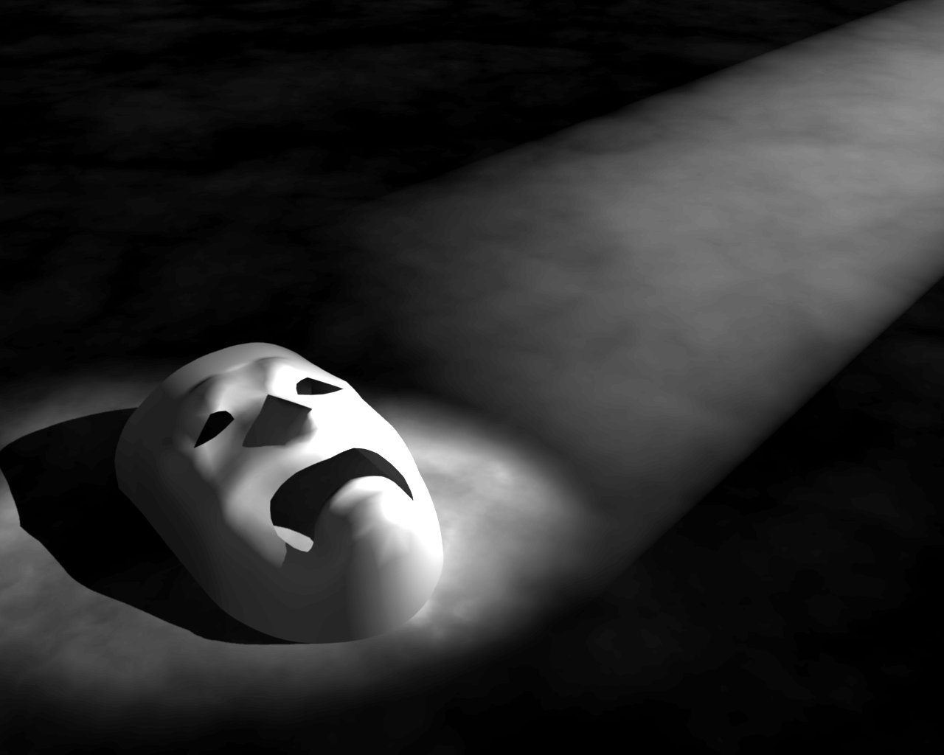
Practice 6 - Context (Tragedy)
Macbeth represents a classic tragedy in that its protagonist travels down a dark path of treachery and violence that inevitably leads to his own downfall and death.
Features of a Tragedy: At the center of the tragedy there is a tragic hero – a main character. The main character has a tragic flaw that brings about their downfall, this is Macbeth’s ambition as he wants too much power. Things turn bad for him when he plots to kill the king. The play often focuses on drama in relationships. The play often contains powerful female characters. A catastrophe occurs, signaling a change of fortune for the main character. Fate predetermines events and there is no escape from it.
The purpose was to make the audience experience pity or fear in response to pain and suffering to help the audience to get rid of these emotions (catharsis).
Macbeth could be considered a didactic text –it has been written to teach the Jacobean audience a lesson.

Slide 17
What have I learned?
Secure the basics
What genre of play is Macbeth?
What causes the downfall of Macbeth’s main character?
Who is Macbeth’s powerful female character?
Master the topic
What was the purpose of a tragedy?
What is a didactic text?
From everything you have read so far, what do you think Shakespeare might be trying to teach his audience?

Slide 18
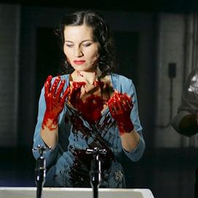
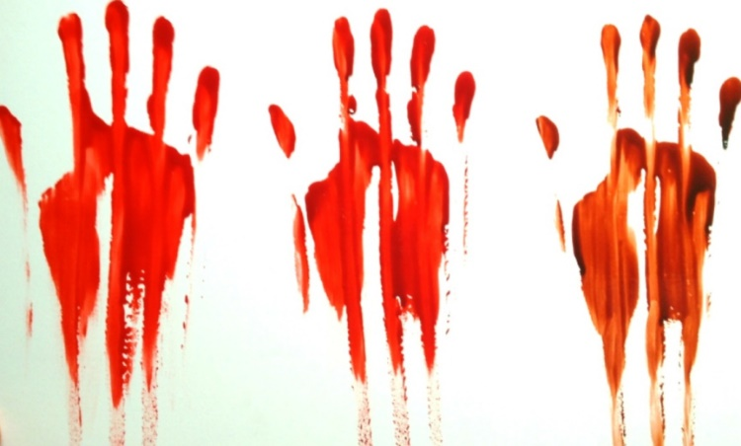
Practice 7 - Context (Symbols - Blood)
Blood is everywhere in Macbeth, beginning with the opening battle between the Scots and the Norwegian invaders, which is described in horrible detail by the wounded captain in Act 1, scene 2.
Once Macbeth and Lady Macbeth embark upon their murderous journey, blood comes to symbolize their guilt, and they begin to feel that their crimes have stained them in a way that cannot be washed clean
“Will all great Neptune’s ocean wash this blood / Clean from my hand?” Macbeth cries after he has killed Duncan, even as his wife aggressively tells him that a little water will do the job (2.2.58–59).
Later, though, she comes to share his horrified sense of being stained: “Out, damned spot; out, I say . . . who would have thought the old man to have had so much blood in him?” she asks as she wanders through the halls of their castle near the close of the play (5.1.30–34).
Blood symbolizes the guilt that sits like a permanent stain on the consciences of both Macbeth and Lady Macbeth, one that pushes them to their graves.

Slide 19
What have I learned?
Secure the basics
What is a symbol?
How does blood first appear in the play?
What does blood begin to symbolize?
Master the topic
How does Macbeth react when he gets the king’s blood on his hands?
What does the feeling of being stained by blood symbolise? Can you think of phrase that links to this?
What does the idea of blood make Macbeth and Lady Macbeth feel like throughout the play?

Slide 20
Practice 8 - Context (Language 1)
In the beginning, the first witch asks her sisters when and under what conditions their next meeting will take place. She suggests that the sisters meet again in what appears to be a number of possible weather conditions that could be good for their witchcraft.
The witches use paradoxes and contradictions to foreshadow how every event that happens will have two opposite sides to it. They mention that the battle that is happening will be lost by one side, but won by the opposite side.
ACT I SCENE I. A desert place.
Thunder and lightning. Enter three Witches
First Witch: When shall we three meet again In thunder, lightning, or in rain?
Second Witch: When the hurly-burly’s done, When the battle's lost and won.
Third Witch: That will be ere the set of sun.
First Witch: Where the place?
Second Witch: Upon the heath.
Third Witch: There to meet with Macbeth.
First Witch: I come, Graymalkin!
Second Witch: Paddock calls.
Third Witch: Anon.
ALL: Fair is foul, and foul is fair: Hover through the fog and filthy air.
Exeunt
The witches continue with these paradoxes with ‘fair is foul, and foul is fair’. It means whatever is fair to a common man is foul to them, and what is foul to a common man is fair to them.
The foul weather and darkness of Macbeth reflect the atmosphere of the play: this will be a story about the dark and ugly side of human nature.
Glossary:
Contradiction – A combination of things that oppose each other.
Paradox – A combination of features that contradict each other.
The witches' rhyming speech makes them seem inhuman, strange, and paranormal, which they are.

Slide 21
What have I learned?
Secure the basics
What weather is good for the witches witchcraft?
What do the witches foreshadow for the future?
What do they say about the battle that is happening?
Master the topic
What is significant about the quote ‘fair is foul, and foul is fair’?
How does Shakespeare use the weather to create atmosphere in this opening?
What does the weather suggest about the tone of the play?
What does the witches rhyming speech make them seem like as characters?

Slide 22
Practice 9- Context and Analysis (Language 2)
Macbeth is first introduced as an extremely masculine figure, shown to the audience through his incredibly violent actions in battle. This fits with the dominant, powerful and even threatening presentation of males in Jacobean England.
This introduction, spoken by a Captain that saw the events of the battle, establishes Macbeth as a powerful, brave warrior and a well-respected man for his bravery.
Look at this extract from Macbeth’s first introduction:
CAPTAIN:
For brave Macbeth--well he deserves that name–
Disdaining fortune, with his brandish'd steel,
Which smoked with bloody execution,
Like valour's minion carved out his passage
Till he faced the slave;
Which ne'er shook hands, nor bade farewell to him,
Till he unseam'd him from the nave to the chaps,
And fix'd his head upon our battlements.
A number of metaphors are used to show present Macbeth to the audience, such as his sword that ‘smoked’ as a result of him killing many men, valour (courage) being his ‘minion’ and how he ‘unseam’d’ his enemy, as though Macbeth is cutting apart fabric and not a human body.
Macbeth is entirely presented to us through violent actions, as verbs like ‘smoked’, ‘carved’, ‘faced’, ‘unseam’d’ and ‘fix’d’ are the main things that give us information about him to begin with.

Slide 23
What have I learned?
Secure the basics
How does Macbeth fit in with Jacobean gender roles in his introduction?
Give one example of how language is used to describe Macbeth as violent.
Who is reporting these events?
Master the topic
What does the speaker seem to think about Macbeth?
What impression do we initially receive of Macbeth here?
What language techniques are used in this extract? Why?

Slide 24
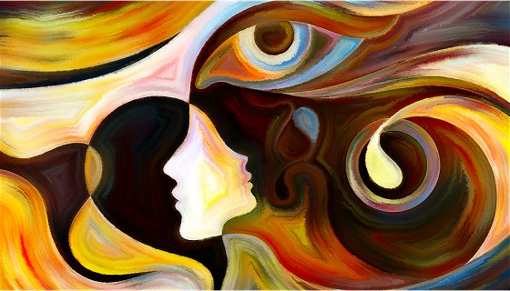
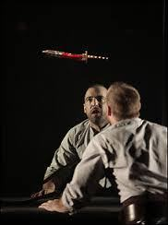
Practice 10 - Hallucinations
In Macbeth, Shakespeare uses the motif of hallucinations as reminders of Macbeth and Lady Macbeth’s joint responsibility for the growing body count as they kill more and more people after King Duncan.
The hallucinations in Macbeth are mostly based on violence, often scaring Macbeth as he shows crazed guilt for his actions.
When he is about to kill Duncan, Macbeth sees a dagger floating in the air. Covered with blood and pointed toward the king’s chamber, the dagger represents the bloody deed that he is about to commit and show’s his weakening mental state.
For example, later, he sees his former friend, Banquo’s ghost sitting in a chair at a feast, picking at his conscience and reminding him that he murdered someone so close. The seemingly tough Lady Macbeth also eventually gives way to visions, as she sleepwalks and believes that her hands are stained with blood that cannot be washed away by any amount of water.
In each case, it is ambiguous whether the vision is real or not there; but, in both cases, the Macbeths read them uniformly as supernatural signs of their guilt from an evil force (presented in the form of the witches).
Glossary:
Hallucinations – Seeing something that is not actually there.
Conscience – A person’s sense of knowing right and wrong.

Slide 25
What have I learned?
Secure the basics
Why does Shakespeare use the motif of hallucinations?
What are the hallucinations mostly based on?
Master the topic
What hallucination does Macbeth have before killing King Duncan?
What does this first hallucination represent?
Who is Banquo? What hallucination does Macbeth have of him?
Who do the Macbeths think are to blame for their visions? Why do you think this is?

Slide 26
Practice 11 - Fate and Prophecies
From the moment the witches tell Macbeth and his friend, Banquo their prophecies, (Macbeth call him Thane of Cawdor and tell him he is going to become a king and that Banquo will have children who are kings) both the characters and the audience are forced to wonder about fate.
They don’t know whether this fate is true, whether action is necessary to make these things happen or whether the prophecy will come true no matter what one does. Macbeth seems happy and wants to know more from them, but Banquo laughs at them.
Unlike Banquo, Macbeth acts: he kills Duncan. Macbeth tries to master fate, to make fate conform to exactly what he wants. But, of course, fate doesn't work that way. By trying to master fate once, Macbeth puts himself in the position of having to master fate always.
At every instant, he has to struggle against those parts of the witches' prophecies that don't favour him.
Ultimately, Macbeth becomes so obsessed with his fate that he becomes delusional: he becomes unable to see the half-truths behind the witches' prophecies. By trying to master fate, he brings himself to ruin.
A character named Ross arrives shortly after to announce that Macbeth has been given the title of Thane of Cawdor. As a result, however, Macbeth believes the Witches and can’t stop thinking about being king. He does become king, just as the prophecy stated, but the Witches didn’t tell him he had to kill King Duncan first. He chooses to do that himself.
Macbeth tries to cheat fate by killing Banquo after the Witches predict that Banquo’s children will be the future kings. Macbeth feels cheated. He has damned himself for someone else’s children. He manages to have his friend assassinated, but unfortunately for Macbeth, Banquo’s son, Fleance escapes.
The Goddess of witchcraft, Hecate is disgusted at Macbeth trying to cheat fate and sets out to cruelly destroy him, saying ‘He shall spurn fate, scorn death, and bear his hopes 'bove wisdom, grace, and fear.’
In the end, Macbeth ignored the Witches’ warning to ‘Beware Macduff’. As fate will have it, Macduff is the one man who can destroy him. Macbeth dies as he has lived: violently. Hecate had this planned out all along.
Glossary:
Fate - the development of events outside a person's control, regarded as predetermined by a supernatural power.

Slide 27
What have I learned?
Secure the basics
What did the witches say was Macbeth’s fate?
What do they think about these predictions?
What does Macbeth do to make the predictions come true?
Master the topic
How does the witches message change Macbeth as a person?
To stop Banquo having sons that are kings, what does Macbeth do?
What does the Goddess of Witchcraft do to Macbeth when she finds out about him stopping Banquo’s fate?

Slide 28
Literacy Task – Macbeth
At the start of the play (Act 1, Scene 2) the bleeding Captain speaks about how Macbeth showed bravery as he fought through the massive "swarm" of enemy soldiers to get to the traitorous Macdonwald, who he then killed and cut to pieces with his sword. The battle flared up again when the "Norwegian Lord" brought new men to the field, but even this didn't stop Macbeth, as he battled back twice as well as before to win the battle.
Look at the following words that might be true of Macbeth:
innocent reckless heroic strong courageous violent cowardly
In the table below, put the words in rank order, with the word you least agree with at the bottom. Then, in the right-hand column, you need to explain why you agree or disagree with the word:
Word | Agree/Disagree

Slide 29
Literacy Task – Lady Macbeth
In Act 1 Scene 5, at Macbeth's home, the castle of Inverness, Lady Macbeth reads a letter from her husband about his meeting with the Witches and on being informed that King Duncan will be paying a royal visit to Inverness, makes up her mind to carry out the murder of the king in order to quicken the prophecy. In doing so, she suggests that her husband is weak — he contains too much of "the milk of human kindness." When Macbeth arrives from the court of Duncan, with news of the king's forthcoming visit, his wife makes her plans clear to him.
Look at the following words that might be true of Lady Macbeth:
manipulative desperate protective disrespectful violent brave determined caring evil
In the table below, put the words in rank order, with the word you least agree with at the bottom. Then, in the right-hand column, you need to explain why you agree or disagree with the word:
Word | Agree/Disagree

Slide 30
Literacy Task – Banquo
Banquo is Macbeth’s best friend who sticks by him in battle, and the Witches promise him that his descendants will be future kings of Scotland. This prediction puts him in mortal danger with Macbeth. Banquo is as ambitious as Macbeth, but unlike Macbeth he resists putting his selfish ambition above his honour or the good of Scotland. Because he both knows the prophecy and is honorable, Banquo is both a threat to Macbeth and a living example of the good path that Macbeth chose not to take. After Macbeth kills him, Banquo reappears after his death as a ghost at Macbeth’s banquet to make him feel guilty.
Look at the following words that might be true of Banquo:
moral noble controlled honourable good desperate loyal honest selfish
In the table below, put the words in rank order, with the word you least agree with at the bottom. Then, in the right-hand column, you need to explain why you agree or disagree with the word:
Word | Agree/Disagree

Slide 31
Literacy Task – King Duncan
King Duncan is a good king who trusts those around him. He is a generous man who wants the best for his kingdom, putting the welfare of Scotland above everything else in his life. After he was told he would one day become king, General Macbeth desires to get the throne as soon as possible and murders the mild-mannered and great King Duncan.
Look at the following words that might be true of King Duncan:
virtuous trusting caring admirable protective naïve innocent
Put the words into the table below, and then next to them, write down whether you think they are characteristics of Mickey or Edward. Write a brief explanation of your choices.
Word | Agree/Disagree

Slide 32
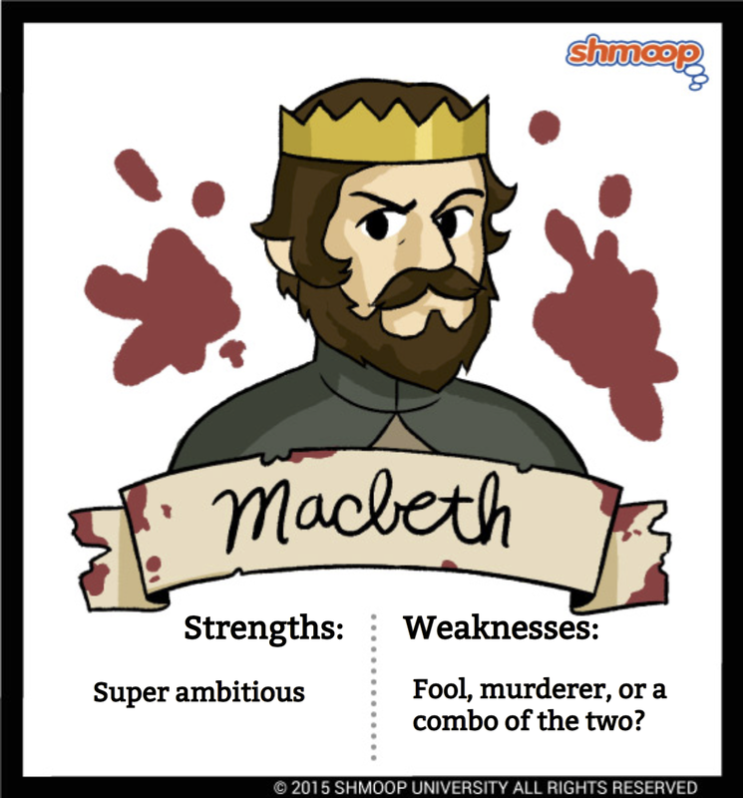
Character Profile- Macbeth
Macbeth is a Scottish general.
Macbeth is also the thane of Glamis.
He is led to wicked thoughts by the prophecies of the three witches, especially after their prophecy that he will be made thane of Cawdor comes true.
Macbeth is a brave soldier and a powerful man, but he is not a virtuous one.
He is easily tempted into murder to fulfil his ambitions to the throne, and once he commits his first crime and is crowned King of Scotland, he embarks on further murders with increasing ease.
He becomes a bad ruler when he is king, much worse than the late King Duncan
Ultimately, Macbeth proves himself better suited to the battlefield than to political intrigue, because he lacks the skills necessary to rule without being a tyrant.
His response to every problem is violence and murder.
Macbeth is never comfortable in his role as a criminal. He is unable to bear the psychological consequences of his bad deeds.

Slide 33
What have I learned?
Secure the basics
What military rank is Macbeth?
What is Macbeth’s title at the start of the play?
What gives him wicked thoughts?
What bad deeds is he led to commit?
Master the topic
What sort of a leader to Macbeth become when he is king?
How does he handle problems when he is king?
How does Macbeth feel about the criminal things he has done?

Slide 34
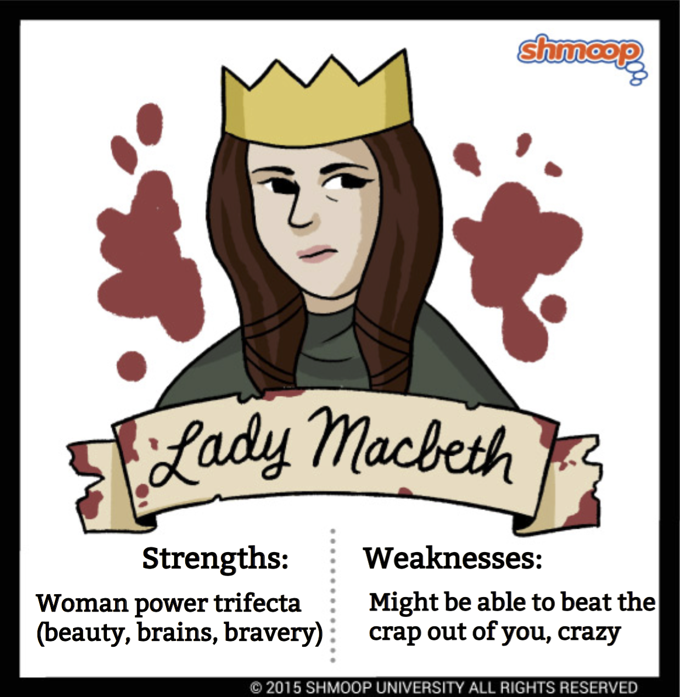
Character Profile- Lady Macbeth
Lady Macbeth is one of Shakespeare’s most famous and frightening female characters.
When we first see her, she is already plotting Duncan’s murder, and she is stronger, more ruthless, and more ambitious than her husband.
She seems fully aware of this and knows that she will have to push Macbeth into committing murder.
At one point, she wishes that she were not a woman so that she could do it herself. This theme of the relationship between gender and power is key to Lady Macbeth’s character: her husband implies that she is a masculine soul in a female body.
Like the Witches, Lady Macbeth uses female methods of achieving power—that is, manipulation—to carry out their supposedly male ambitions like killing.
Even though women were supposed to be kind and gentle, Lady Macbeth shows that women can be equally as cruel.
When Macbeth hesitates to murder, she repeatedly questions his manhood until he feels that he must commit murder to prove himself.
Lady Macbeth’s remarkable strength of will persists through the murder of the king—it is she who calms her husband’s nerves immediately after the crime has been committed.
Afterward, however, she begins a slow slide into madness—just as ambition affects her more strongly than Macbeth before the crime, so does guilt plague her more strongly afterward.
By the close of the play, she has been reduced to sleepwalking through the castle, desperately trying to wash away an invisible bloodstain.
Once she feels guilty, Lady Macbeth’s sensitivity becomes a weakness, and she is unable to cope. Significantly, she (apparently) kills herself, signalling her total inability to deal with the guilt of their crimes.

Slide 35
What have I learned?
Secure the basics
How does Lady Macbeth compare to her husband?
What does she do when Macbeth feels like he can’t kill the king?
Why does she wish that she wasn’t a woman?
How does she get power?
How is Lady Macbeth different to a typical Jacobean woman?
How does she pressure Macbeth?
Master the topic
What does she do after her husband eventually kills the king?
How does her attitude change after this?
At the end of the play, how has she changed as a character?
What happens to her at the end of the play and what does this show?

Slide 36
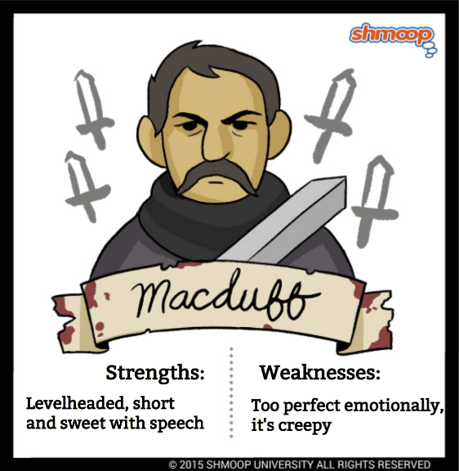
Character Profile- Macduff
At the beginning of the play, Macduff is a loyal and brave noble fighting on Duncan’s side.
He immediately distrusts Macbeth’s claim that Duncan was killed by his servants, and refuses to go to Macbeth’s coronation.
Once Macbeth understands that Macduff will not be loyal to him, Macduff becomes a particular focus of Macbeth’s anger, guilt, and rabid desire to protect his power.
Macbeth arranges for murderers to kill Macduff’s wife and children, after Macduff has already fled to England to seek help from the king for his cause against Macbeth.
Macduff’s decision to abandon his family is never fully explained, and seems hard to justify, given their brutal murders.
But Macduff is deeply motivated by his wife and sons’ deaths, and speaks several times in the play about how he must revenge them.
His mission to place Malcolm on the throne of Scotland is one that reflects his desire to have the true monarch ruling, but also shows his desire for vengeance for his wife and son’s murder.
Macduff eventually kills Macbeth and cuts his head off to help restore order to Scotland.
Glossary:
Coronation - the ceremony of crowning a member of royalty, usually a king or queen.

Slide 37
What have I learned?
Secure the basics
What does Macduff do at the start of the play?
What claim of Macbeth’s does Macduff not trust?
What does Macbeth think about Macduff? Why?
What does Macbeth arrange to happen to Macduff?
Master the topic
What does Macduff want revenge for?
What does Macduff’s mission become? Why?
What does Macduff eventually do to end the play?

Slide 38
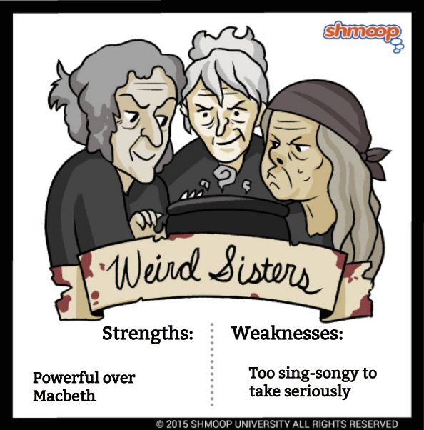
Character Profile- The Three Witches
Throughout the play, the witches—referred to as the “weird sisters” by many of the characters—lurk like dark thoughts and unconscious temptations to evil.
The mischief they cause stems from their supernatural powers, but mainly it is the result of their understanding of the weaknesses of Macbeth—they play upon Macbeth’s ambition like puppeteers.
The witches’ beards, bizarre potions, and rhymed speech make them seem slightly ridiculous, like caricatures of the supernatural.
Shakespeare has them speak in rhyming couplets throughout (their most famous line is probably “Double, double, toil and trouble, / Fire burn and cauldron bubble” in 4.1.10–11), which separates them from the other characters, who mostly speak in blank verse.
The witches’ words seem almost comical, like nursery rhymes. However, they are clearly the most dangerous characters in the play, being both tremendously powerful and utterly wicked.
The audience is left to ask whether the witches are by themselves toying with human lives, or agents of fate, whose prophecies are only reports of what should happen.
Some of their prophecies seem self-fulfilling. For example, it is doubtful that Macbeth would have murdered his king without the push given by the witches’ predictions.
In other cases, though, their prophecies are just accurate readings of the future—it is hard to see Birnam Wood coming to Dunsinane as being self-fulfilling in any way.
They communicate with the Goddess of Witchcraft, Hecate, who tells them she has a plan to end the life of Macbeth.

Slide 39
What have I learned?
Secure the basics
What are the three witches also referred to as?
What is their role in the play? What do they do?
How do they speak? In what form of poetry?
Master the topic
What did the witches’ predictions cause Macbeth to do?
What accurate reading of the future do they make?
How do they change Macbeth’s behavior overall?
Who do the witches communicate with?

Slide 40
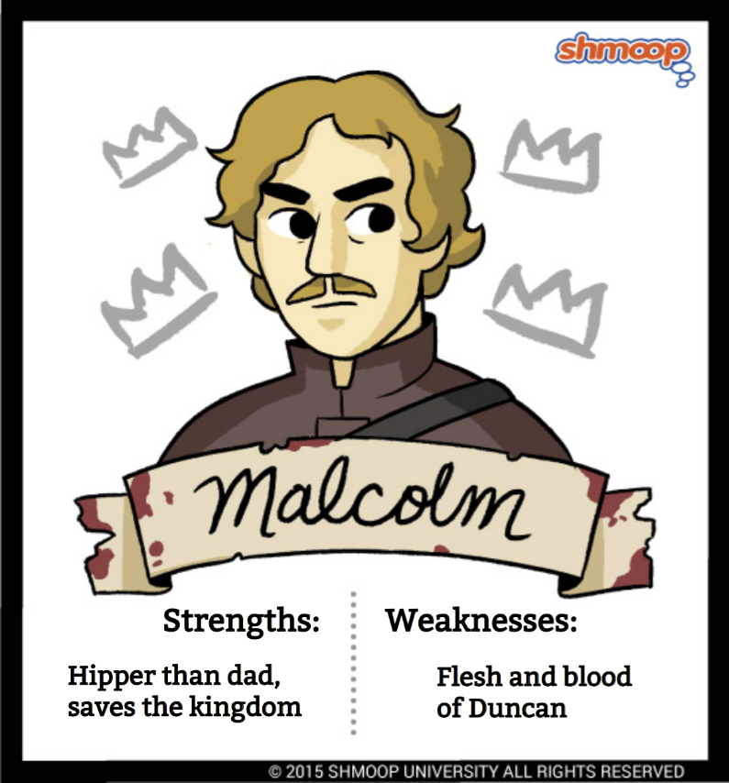
Character Profile- Malcolm
With his brother Donalbain, Malcolm quickly realises the danger of staying in Scotland after King Duncan, their father is killed and flees the country.
By the time he reappears, in Act IV, Scene 3, he has won the support of Edward the Confessor (king of England), he has his own army under Northumberland and Siward, and he is like a king.
Towards the end of the play he tests Macduff to check if he is loyal, with this loyalty being a big part of his character.
Malcolm only wants to strengthen the prospect of good. This is in stark contrast to Macbeth, who plays a part in order to advance his own evil.
In the final scene of the play, Malcolm is presented as the future king. His use of the phrase "by the grace of Grace" indicates the importance that he attaches to the service of good and reminds the audience of his direct descent from one who ruled by divine right, as opposed to Macbeth, who took the throne. Like his father Duncan, Malcolm is the representative of order.

Slide 41
What have I learned?
Secure the basics
What does Malcolm do immediately after his father, King Duncan is killed?
What did he organise in order to take back the throne from Macbeth?
Who did he command?
Master the topic
What does Malcolm do to Macduff at the end of the play? Why?
What does Malcolm want? What does this show about him?
What does Malcolm do to end the play? What does this show?

Slide 42
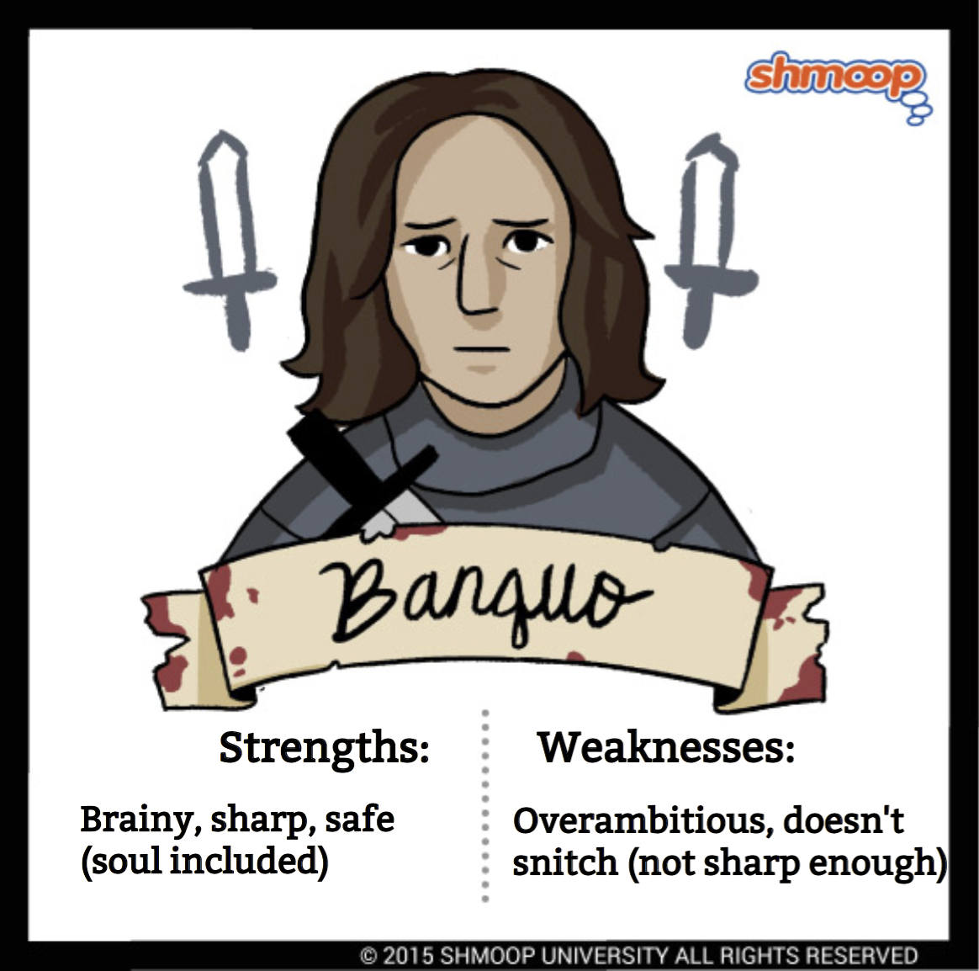
Character Profile- Banquo
Banquo is Macbeth’s brave and noble best friend, as well as his second victim.
Banquo enters the play with Macbeth after both have fought valiantly for Duncan’s side in a recent battle.
Duncan acknowledges Banquo as “no less deserved” of praise than Macbeth, but from the beginning of the play Banquo is overshadowed by Macbeth’s accomplishments and ambition.
However, Banquo is not entirely without ambition of his own. He asks for a prophecy from the Witches, too, and is pleased to learn that his children will rule Scotland.
Similar to Macbeth, Banquo seems unable to understand the cost of the Witches’ prophecy will be his life.
In Act III, murderers kill Banquo at Macbeth’s command, and try to kill his young son, Fleance, who manages to get away.
Soon after his death, Banquo appears in the form of a ghost at the banquet the Macbeths give at their castle.
At play’s end, Banquo’s greatest import remains offstage: his son, Fleance, who could come back to revenge his father’s death and take the throne of Scotland, fulfilling the Witches’ prophecy that Banquo’s sons will one day be king.

Slide 43
What have I learned?
Secure the basics
What is Banquo’s relationship to Macbeth?
How does Banquo enter the play?
What do people think about Banquo compared to Macbeth?
What does Banquo not understand about the witches’ prophecy?
Master the topic
What happened to Banquo in Act III? Why?
How does Banquo reappear after his death?
How does the ending of the play relate to Banquo?

Slide 44
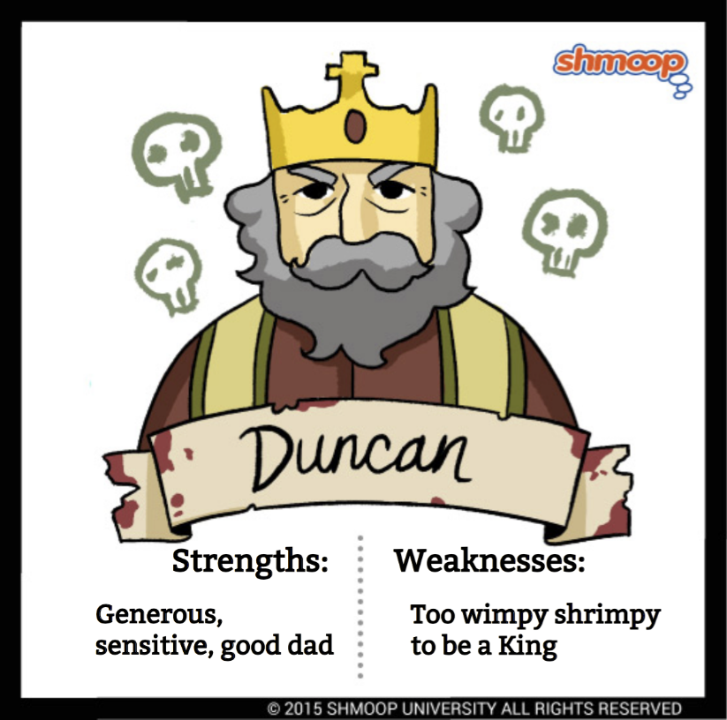
Character Profile- King Duncan
The king of Scotland should be a figurehead of order and orderliness, and Duncan is the perfect example of this.
His language is formal and his speeches full of kindness, whether on the battlefield in Act I, Scene 2, or when greeting his kind hostess Lady Macbeth in Act I, Scene 6.
Duncan also expresses humility (a feature that Macbeth lacks) when he admits his failure in spotting the previous Thane of Cawdor's treachery: "There's no art to find the mind's construction in the face" (I: 4,11).
Most importantly, Duncan is the representative of God on earth.
He rules by divine right (ordered by God), a feature of kingship supported by King James I, for whom the play was performed in 1606.
This "divinity" of the king is made clear on several occasions in the play, most notably when Macbeth talks of the murdered Duncan as having "silver skin lac'd with . . . golden blood" (Act II, Scene 3).
Glossary:
Humility – Having a low view of one’s self
Treachery – Betrayal of trust

Slide 45
What have I learned?
Secure the basics
What sort of a king is Duncan?
What is his language like?
What quality does Duncan have that Macbeth doesn’t?
Master the topic
How is he viewed by other characters?
Who does King Duncan represent? Why?
How does he link to King James I?
How is Duncan described as divine?

Slide 46
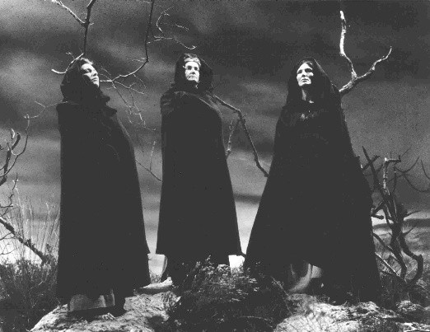
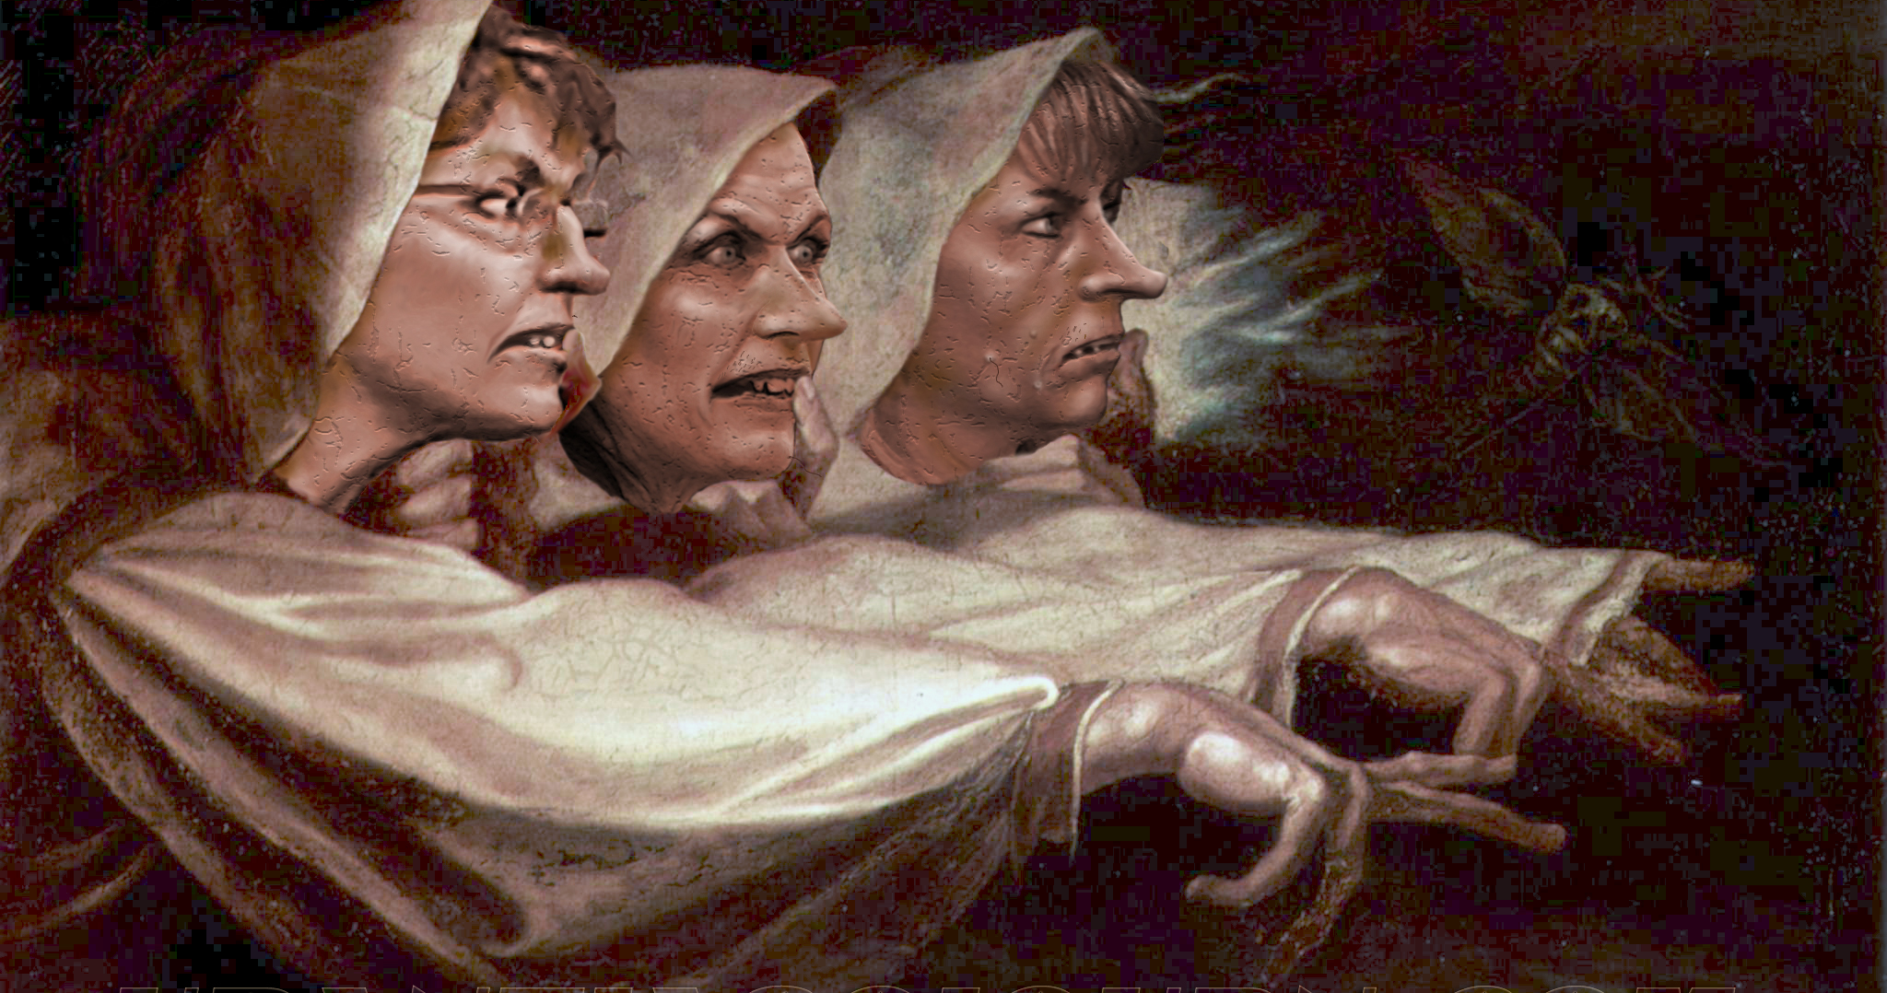
Act One: The witches’ prophecy
Thunder and lightning crash above a Scottish moor. Three haggard old women, the witches, appear out of the storm. In eerie, chanting tones, they make plans to meet again upon the heath, after the battle, to confront Macbeth. As quickly as they arrive, they disappear.
Macbeth begins in "an open place" — a place without any landmarks or buildings — with this appearance of the three "weird sisters," as they later call themselves.
The darkness of the scene shows both the wild Scottish landscape in which the play is set and the foreshadows the tone of the events of the play.
The Three Witches' speech is written in short rhyming verse that sounds like the casting of a spell. The women's language is also full of the imagery of witchcraft and of chaotic weather: thunder, lightning, rain, fog, and "filthy air."
These are the kind of riddles we would expect from witches; on the other, the lines suggest a paradox that runs throughout the play: Life often seems like a confused picture of events and separating what is true and what is a lie is difficult.
The lines:
"When the battle's lost and won"
and
"Fair is foul and foul is fair"
are the most significant in the scene.

Slide 47
What have I learned?
Secure the basics
What are the witches’ plans?
Where does the play begin?
What does the darkness show?
Master the topic
How do the witches speak?
Why do they use paradoxes in their speech? What does this show?

Slide 48
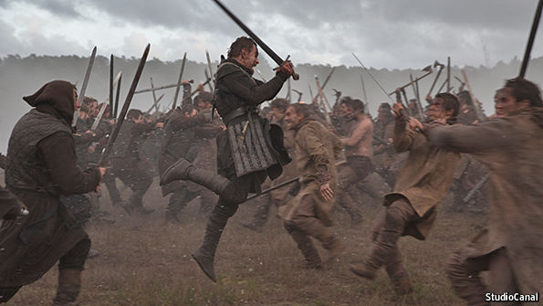
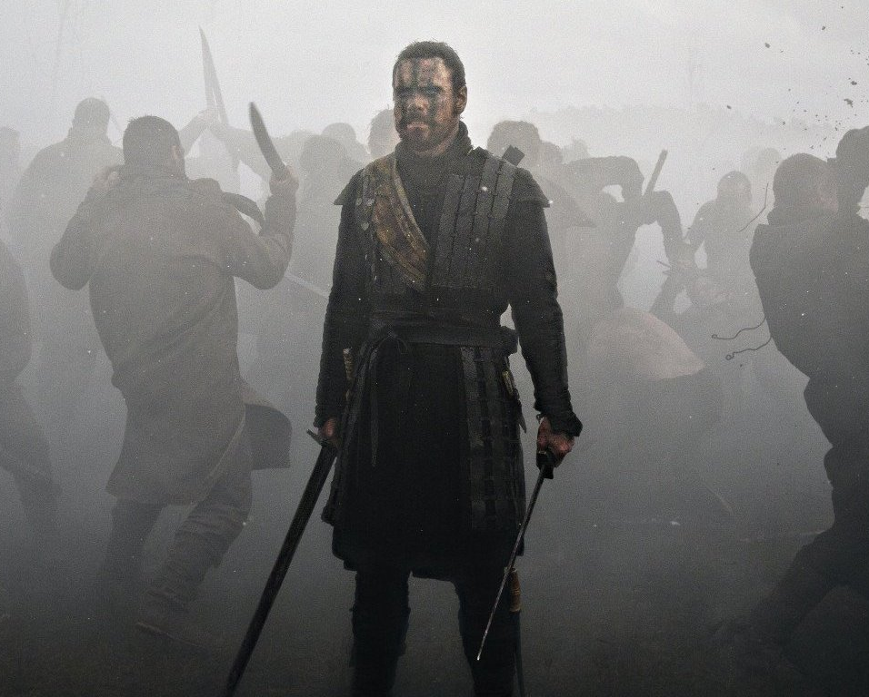
Act One: The Brave Macbeth
A wounded officer brings King Duncan news of Macbeth's bravery in battle. He talks about how soon after he defeats the Irish rebel Macdonwald, he begins fighting the massive Norwegian army.
The captain, who was wounded helping Duncan’s son, Malcolm escape capture by the Irish, replies that the Scottish generals, Macbeth and Banquo fought with great courage and violence.
The captain then describes for Duncan how Macbeth killed the traitorous Macdonwald. As the captain is carried off to have his wounds attended to, the thane of Ross, a Scottish nobleman, enters and tells the king that the traitorous thane of Cawdor has been defeated and the army of Norway repelled.
Duncan decides that the thane of Cawdor is put to death and that Macbeth, the hero of the victorious army, be given Cawdor’s title. Ross leaves to deliver the news to Macbeth.
The Captain uses the adjective brave to describe Macbeth (And then reinforces it with "well he deserves that name"). Shakespeare is desperate for his audience and the King to appreciate Macbeth’s courage and his actions through showing him in a positive light and as patriotic.
CAPTAIN
For brave Macbeth, well he deserves that name.

Slide 49
What have I learned?
Secure the basics
Who is King Duncan talking to in this scene?
Who are the Scottish generals?
What thane was a traitor to Scotland?
Master the topic
Who gets given the traitor’s title?
Who delivers the news of this to Macbeth?
Why does the captain describe Macbeth in the way that he does?

Slide 50
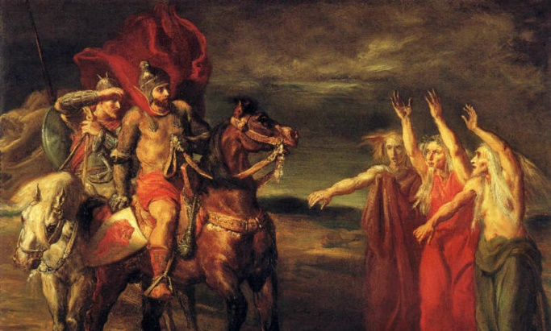
Act One: The Witches Prophecy
After the battle, Macbeth and Banquo are travelling upon a heath until they encounter some strange looking figures.
The men encounter the witches ‘that look not like th’inhabitants o’th’earth’. The witches hail Macbeth firstly by his title Thane of Glamis, then as Thane of Cawdor and finally as ‘king hereafter!’ Banquo says there is no need to ‘fear things that sound so fair’, and asks the witches for his future.
They predict that his children will be 'kings, though thou be none’. Macbeth demands to know how their prediction about him can be true when the Thane of Cawdor is still alive but the witches vanish.
Ross and Angus arrive to tell Macbeth that he has been given the title Thane of Cawdor by Duncan to thank him for his valiant efforts in the battle. Macbeth considers ‘this supernatural soliciting’.
MACBETH
This supernatural soliciting
Cannot be ill, cannot be good. If ill,
Why hath it given me earnest of success,
Commencing in a truth? I am thane of Cawdor.
If good, why do I yield to that suggestion
Whose horrid image doth unfix my hair
And make my seated heart knock at my ribs
He realises that to become king, Duncan would have to die but he thinks this is a ‘horrid image’. Then he adds in an aside that ‘chance may crown me, without my stir’. Banquo and Macbeth decide to discuss the witches’ prophecies at a later time.

Slide 51
What have I learned?
Secure the basics
After the battle, where are Macbeth and Banquo?
What do the witches call Macbeth?
What do the witches do when Macbeth asks them to tell him more?
Master the topic
Who come to deliver the King’s message to Macbeth?
What does Macbeth realise he must do now if he wants to become king?

Slide 52
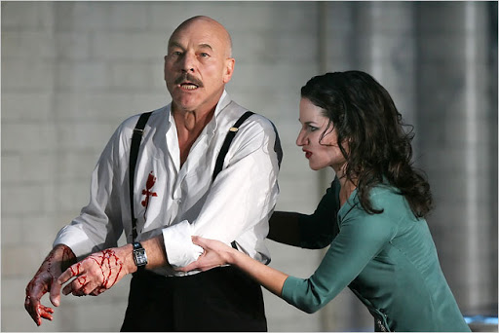
Act One: The King’s Visit
King Duncan asks about the execution of Cawdor. King Duncan's son Malcolm reports that he confessed and died nobly. Macbeth and Banquo, along with Ross and Angus, join the rest of Duncan’s party.
Duncan thanks them both for their part in the battle and announces that his eldest son, Malcolm, will inherit the throne from him when he dies. Duncan then says they will visit Macbeth’s castle as they travel ‘from hence to Inverness’ and will celebrate there. Macbeth decides to go on ahead to tell his wife. He remarks to himself that Malcolm is now ‘a step on which I must fall down, or else o’erleap’ to get to the throne.
Lady Macbeth reads a letter from her husband about his encounter with the witches. She fears that her husband is ‘too full o’th’milk of human kindness to catch the nearest way’ of achieving the throne. She wants him to come home quickly so that she can ‘pour’ her words of ambition into his ears.
She is interrupted by news that the king is coming to the castle that evening and that Macbeth is already on his way. She celebrates the ‘fatal entrance’ of Duncan into their home. She calls on evils spirits to ‘unsex’ her and make her capable of murder. Macbeth arrives home and Lady Macbeth immediately plants the seed of her murderous intentions. She advises him to hide their plans with innocence, but be a ‘serpent’ underneath.
Later on that night, outside the banqueting hall, Macbeth considers his thoughts about killing Duncan. He struggles with his conscience and decides not to go through with it because it is only his ‘vaulting ambition’ that is pushing him onwards. Lady Macbeth tells him off for leaving the hall.
When Macbeth tells her that he has decided against killing Duncan, she is furious, calling him a coward and a ‘beast’. She goads him by saying that she would have ‘dash’d the brains out’ of her own baby if she had promised it to him.
Macbeth is further persuaded by the strength of their plan. She will give Duncan’s two guards so much wine that they ‘lie as in death’, allowing Duncan to be an unguarded target for Macbeth to attack in the night. They will frame the guards for Duncan’s murder by covering their daggers in Duncan’s blood. The final step of the plan is for Lady Macbeth and Macbeth to act horrified on the discovery of the murder and ‘clamour roar / Upon his death’. Macbeth is ‘settled’ to kill Duncan.

Slide 53
What have I learned?
Secure the basics
What happened to the former Thane of Cawdor?
Who does King Duncan announce will inherit his throne when he dies?
When Lady Macbeth reads the letter about what the witches said, what does she fear?
What does Lady Macbeth call on to help her kill the king that night?
How does Macbeth originally feel about killing the king?
Master the topic
How does Lady Macbeth react when Macbeth says that he won’t kill the king?
What makes Macbeth finally decide to kill the king?
Who are they going to blame for the murder?

Slide 54
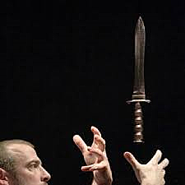
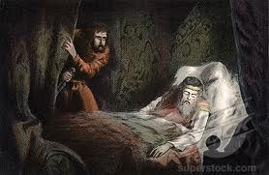
Act Two: Macbeth’s vision of a bloody dagger.
In the middle of the night, Banquo and his son Fleance unexpectedly meet Macbeth. They are surprised he is still awake. Banquo gives Macbeth a diamond from Duncan to thank him for an enjoyable evening. Banquo tells him that he dreamed of the ‘three weird sisters’ last night, but Macbeth lies and says he has not thought about them.
Alone, as he goes towards Duncan’s chambers to murder the king, Macbeth sees a vision of a bloody dagger. He dismisses the vision, saying that it is the ‘bloody business’ that is causing him to hallucinate. Macbeth speaks in soliloquy (aloud and by himself, to project his thoughts and feelings).
For now, the appearance of a bloody dagger in the air unsettles Macbeth shown by how he questions himself. Even he doesn't know whether the dagger is real or a figment of his guilty imagination. Macbeth will suffer more frightening apparitions in the scenes that follow, and Lady Macbeth will go mad trying to scrub away blood on her hands that only she can see. As Macbeth fears, the murder of Duncan is not a deed that will be "done, when 'tis done."
MACBETH
Is this a dagger which I see before me,
The handle toward my hand? Come, let me clutch thee.
I have thee not, and yet I see thee still.
Art thou not, fatal vision, sensible
To feeling as to sight? Or art thou but
A dagger of the mind, a false creation,
Proceeding from the heat-oppressèd brain?
The last vestiges of the honourable Macbeth die at the end of this speech. It is a match between Macbeth's ambition and revulsion. The bell ultimately tolls for Macbeth as it does for Duncan; the dagger of the mind is as potent a killer as the dagger Macbeth wields in murder.

Slide 55
What have I learned?
Secure the basics
What did Banquo dream of?
Where is Macbeth going that night?
What does Macbeth see?
In what form does Macbeth speak his thoughts and feelings?
Master the topic
How does the vision make Macbeth feel?
What does the object he sees symbolise?
What signals Macbeth’s time to kill Duncan?

Slide 56
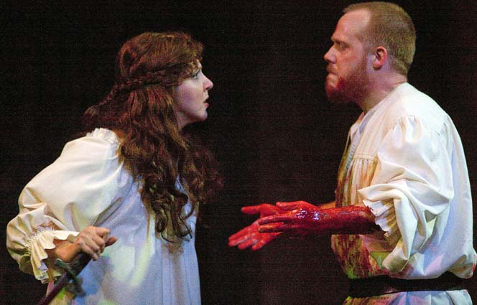
Act Two: The aftermath of the king’s murder
Lady Macbeth waits fitfully for Macbeth to return from killing Duncan. Upon hearing a noise within, she worries that the bodyguards have awakened before Macbeth has had a chance to plant the evidence on them.
Macbeth enters, still carrying the bloody daggers with which he killed Duncan. He is deeply shaken: as he entered Duncan's chamber, he heard the bodyguards praying and could not say "Amen" when they finished their prayers.
Lady Macbeth’s counsels to think "after these ways” as “it will make [them] mad" (32). Nonetheless, Macbeth also tells her that he also thought he heard a voice saying, "’sleep no more, / Macbeth does murder sleep. . . Glamis hath murdered sleep, and therefore Cawdor / Shall sleep no more, Macbeth shall sleep no more" (33-41). Lady Macbeth again warns him not to think of such "brain-sickly of things" and tells him to wash the blood from his hands (44).
Seeing the daggers he carries, she chastises him for bringing them in and tells him to plant them on the bodyguards according to the plan. When Macbeth, still horrified by the crime he has just committed, refuses to re-enter Duncan’s chamber, Lady Macbeth herself brings the daggers back in.
The power dynamic between Macbeth and Lady Macbeth becomes clear here, in which Lady Macbeth is in control and collected, compared to her weaker and bothered husband. This is highlighted through her authoritative tone and her use of imperative commands, like the command to give her the daggers before she leaves to smear blood on the bodies of the king’s guards.
This challenges the gender norms of Jacobean England, as women would never have control over her husband or be orchestrating such awful deeds as these.
LADY MACBETH
Infirm of purpose!
Give me the daggers. The sleeping and the dead
Are but as pictures. 'Tis the eye of childhood
That fears a painted devil. If he do bleed,
I’ll gild the faces of the grooms withal,
For it must seem their guilt.

Slide 57
What have I learned?
Secure the basics
What does Lady Macbeth wait for in her chamber?
What could Macbeth not say when he was entering King Duncan’s chamber?
What did Macbeth think he heard a voice say as he murdered the king?
What does Lady Macbeth have to do with the daggers that Macbeth is holding?
Master the topic
Who is in charge in Macbeth and Lady Macbeth’s relationship at this point?
How would a Jacobean audience have reacted to this?

Slide 58
Act Two: The king’s body is found
The Porter answers the door of the castle to two men, Macduff and Lennox, who have come to meet with Duncan. Macduff remarks that the household must have gone to bed very late to sleep in so long. Macbeth shows Macduff to Duncan’s chambers, where he uncovers the horrible murder.
They sound alarms which wake all the sleeping thanes and Lady Macbeth. Lennox tells Duncan’s sons that their father has been murdered by his guards, and Macbeth explains that he killed the guards out of ‘fury’.
Macduff questions why Macbeth did this. While Macbeth tries to explain his reasons, Lady Macbeth faints. Led by Banquo, the lords swear to investigate the murder. Fearing for their lives, Malcolm decides to go to England and Donalbain decides to go to Ireland.
Ross talks about a series of unnatural things that have been happening, including how the horses have ‘turned wild in nature’ and begun to eat each other, and it's dark in the day time.
Macduff arrives and tells Ross that he believes that the guards who murdered Duncan were bribed by Malcolm and Donalbain, which is why the two sons have fled the country. Ross reports that Macbeth has been named king and he plans to go to Scone for his coronation but Macduff heads home to Fife instead.
Ross and an old man discuss the unnatural events that have taken place recently: days are as dark as nights, owls hunt falcons, and Duncan's horses have gone mad and eaten each other. This shift to darkness in the land symbolises the end of all that is good and the beginning of the Macbeth’s illegitimate reign.
When Macduff enters, Ross asks whether the culprit has been discovered. Macduff tells him that the bodyguards killed the king. The hasty flight on the part of Malcolm and Donalbain, however, has also cast suspicion on the two sons as well.
ROSS
Ha, good father,
Thou seest the heavens, as troubled with man’s act,
Threatens his bloody stage. By th' clock ’tis day,
And yet dark night strangles the travelling lamp.
Is ’t night’s predominance or the day’s shame
That darkness does the face of Earth entomb
When living light should kiss it?
Ross comments that Macbeth will surely be named the next king, to which Macduff responds that he has already been named and has gone to Scone to be crowned. Ross leaves for Scone to see the coronation while Macduff does not want to and heads home to Fife.

Slide 59
What have I learned?
Secure the basics
Who answers the door of the castle and who enters?
Macbeth murders the king’s guards, what is his explanation for why?
How does Lady Macbeth distract the attention from her husband?
How has Scotland changed after the king’s murder?
Master the topic
What strange things happen after the king’s death?
What do these strange things represent?
Who is going to be named the next king? How do people seem to feel about this?

Slide 60
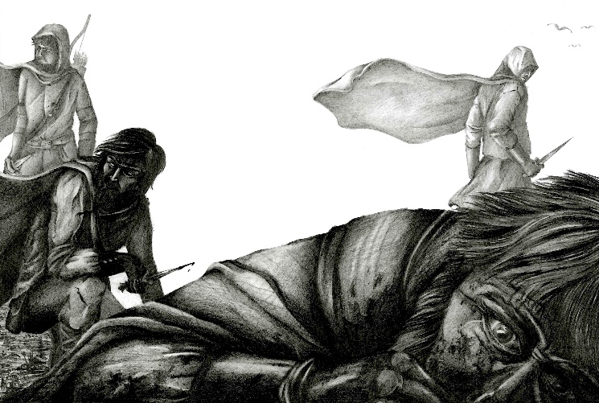

Act Three: The assassination of Banquo
Banquo suspects that Macbeth played ‘most foully’ to achieve the throne. Lady Macbeth and Macbeth invite Banquo to a ‘solemn supper’ that evening. Banquo and his son Fleance are going out riding that afternoon, but Banquo promises to return in time for the banquet.
Macbeth tells Banquo that he has heard that Malcolm and Donalbain are spreading terrible rumours. When Banquo goes, Macbeth delivers a soliloquy about his fears that Banquo’s children will become future kings. If true, his murderous deeds to seize the ‘barren sceptre’ will have been fruitless for his own family. He convinces two murderers to kill Banquo and his son Fleance.
Lady Macbeth is concerned about Macbeth’s misery. She advises him not to think on past deeds saying ‘what’s done is done’. Macbeth is plagued by fears about potential threats and ‘terrible dreams’.
He envies Duncan who ‘sleeps well’ in his grave. Lady Macbeth encourages Macbeth to put on a brave face for his guests that evening. He tells his wife that his mind is ‘full of scorpions’ with fears about Banquo and Fleance. He will not tell her what he has done but asks the ‘seeling night’ to disguise his deeds.
The murderers then attack Banquo and Fleance. Fleance manages to escape and Banquo shouts after him, ‘Thou mayst revenge!’ and Banquo is killed. The murderers decide to return to the castle and tell Macbeth.
The killing of the king and now the swift killing of his best friend most effectively shows Macbeth’s hamartia (meaning his ‘fatal flaw’) which is his ambition. He suffers from the flaw of wanting too much and does awful things to get it. This leads to his progressive corruption and the downfall of his character.

Slide 61
What have I learned?
Secure the basics
What does Banquo suspect about Macbeth?
What does Macbeth say he fears in his soliloquy?
What does Lady Macbeth advise to her husband?
How does Macbeth feel about their murder of the king?
Master the topic
Why does Macbeth envy King Duncan? How do you know this?
Why did Macbeth have Banquo assassinated? Do you think he wanted to?
What is Macbeth’s fatal flaw and how is it affecting his conscience?

Slide 62
Act Three: Banquo’s ghost
Guests arrive for the banquet. Macbeth sees one of the murderers arrive with blood on his face and is pleased to hear that Banquo is dead in a ditch ‘with twenty trenched gashes on his head’. He is disappointed that the ‘worm’ Fleance escaped but he reassures himself that there is no immediate threat because Fleance is so young.
As the banquet begins, the ghost of Banquo sits in Macbeth’s place at the table. Macbeth is visibly shaken but Lady Macbeth calms the guests by saying that it is a momentary fit. Lady Macbeth criticises Macbeth for his ‘flaws and starts’ when he is only looking at a ‘stool’.
The ghost then goes away but, as Macbeth makes a toast to ‘our dear friend Banquo’, it reappears and he cries out at the ghost saying ‘Hence, horrible shadow!’. It vanishes again but Lady Macbeth says he has ‘displaced the mirth’ and tells the guests to leave.
Alone, Macbeth and Lady Macbeth discuss how Macduff declined their invitation and did not come to the banquet. Macbeth decides that he will visit the witches again the next day. Lady Macbeth says he lacks ‘the season of all nature, sleep’ but Macbeth says there is no turning back now; they are ‘yet but young in deed’.
The appearance of Banquo's ghost reminds us that Macbeth, despite his absolute power, isn't enjoying life as king of Scotland. A basically decent man brought low by overwhelming ambition, Macbeth still has enough of a conscience to be tormented by his guilty actions.
Macbeth may have convinced himself that he can somehow hide from the terrible truth of his blood-stained dictatorship by retreating into the realm of the supernatural. But as the unwelcome arrival of Banquo's ghost demonstrates, that's nothing more than a delusion. Macbeth can run from his crimes, but he can't hide from them. Lady Macbeth has to attempt to cover for her husbands mania.
MACBETH
(to GHOST) Thou canst not say I did it. Never shake
Thy gory locks at me.
ROSS
Gentlemen, rise. His highness is not well.
ROSS
Gentlemen, stand up. His highness is not well.
LADY MACBETH
Sit, worthy friends. My lord is often thus
And hath been from his youth. Pray you, keep seat.
The fit is momentary; upon a thought
He will again be well. If much you note him,
You shall offend him and extend his passion.
Feed and regard him not. (aside to MACBETH) Are you a man?

Slide 63
What have I learned?
Secure the basics
What does Macbeth see at his evening banquet?
Why does Lady Macbeth criticise her husband?
Who does Macbeth order a toast to?
Who declined the Macbeths’ invitation to come to the banquet?
Master the topic
What does the appearance of Banquo’s ghost remind us?
Why do you think he is seeing Banquo’s ghost sat at the table?

Slide 64
Act Three – Lady Macbeth’s control
Lady Macbeth’s role as a woman who can transcend the boundaries of her female sex and display power through manipulation is once again used during the banquet by Shakespeare. This transcendent quality is exactly what makes her dangerous, as she is in control of her sexuality and does not submit to the passive role that was expected of females in Jacobean England. Before telling their guests to leave, Lady Macbeth once again chides her husband.
LADY MACBETH
O proper stuff!
This is the very painting of your fear:
This is the air-drawn dagger which, you said,
Led you to Duncan. O, these flaws and starts,
Impostors to true fear, would well become
A woman's story at a winter's fire,
Authorised by her grandma. Shame itself!
Why do you make such faces? When all's done,
You look but on a stool.
Highlight all examples of Lady Macbeth’s criticisms of her husband’s behaviour.
How would you describe Lady Macbeth’s behavior towards her husband here?
How would you describe Macbeth’s behavior in this scene?
What does Lady Macbeth say is the cause for her husband’s visions here?
How is this extract used by Shakespeare to show us the differences between Macbeth and Lady Macbeth at this point?

Slide 65
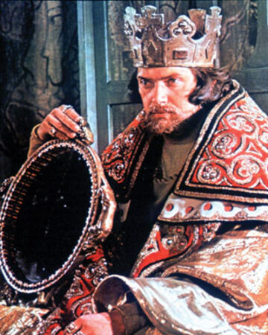
Act Three: Macbeth’s tyranny
After all the guests leave and Macbeth and Lady Macbeth are alone, they discuss how Macduff declined their invitation and did not come to the banquet.
Macbeth decides that he will visit the witches again the next day. Lady Macbeth says he lacks ‘the season of all nature, sleep’ but Macbeth says there is no turning back now; they are ‘yet but young in deed’.
As they go to sleep, the focus then shifts to Hecate, the Goddess of Witchcraft, who is angry with the witches for giving prophecies to Macbeth without consulting her. She tells them to meet her in the morning where they will tell Macbeth his ‘destiny’ and lead him on to ‘his confusion’.
Lennox is deeply suspicious about the murders of ‘gracious Duncan’ and ‘right-valiant Banquo’. He reports how Macduff ‘lives in disgrace’ since missing the Macbeths’ feast and another lord recounts how Macduff has gone to England to seek help in overthrowing Macbeth, calling him a ‘tyrant’.
LORD
The son of Duncan—
From whom this tyrant holds the due of birth—
Lives in the English court and is received
Of the most pious Edward with such grace
That the malevolence of fortune nothing
Takes from his high respect. Thither Macduff
Is gone to pray the holy king upon his aid
To wake Northumberland and warlike Siward,
That by the help of these—with Him above
To ratify the work—we may again
Give to our tables meat, sleep to our nights,
Free from our feasts and banquets bloody knives,
Do faithful homage and receive free honors.
All which we pine for now. And this report
Hath so exasperated the king that he
Prepares for some attempt of war.
At this point, the thanes are able to see Macbeth for what he is: a tyrant. Macduff has acted upon this, and gone to England to meet with Malcolm and try to get the English King Edward and his lords to gather an army to help them defeat Macbeth.

Slide 66
What have I learned?
Secure the basics
Who declined the Macbeths invitation to their banquet?
Who is Macbeth going to ask for help the following day?
Master the topic
What supernatural being is angry at Macbeth? Why?
Who is suspicious of Macbeth at this point and why?
What is Macduff’s plan to get rid of Macbeth?

Slide 67
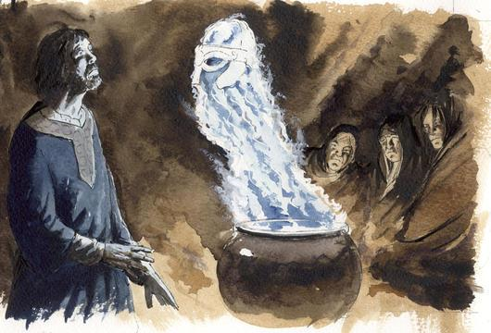
Act Four: Macbeth visits the witches and has Macduff’s family killed
The witches cast a spell around a cauldron and Hecate congratulates them. Macbeth visits the witches and they show him three apparitions.
Firstly, a helmeted head appears saying that Macbeth should ‘beware Macduff’. Secondly, a bloody child appears, saying ‘none of woman born shall harm Macbeth’. Thirdly, a crowned child holding a tree appears, saying that he will never be defeated ‘until Great Birnam Wood to high Dunsinane hill shall come against him’.
Macbeth is reassured, but asks if Banquo’s descendants will ever reign. The witches advise against his question, but he demands that they answer. An apparition of eight kings appears following Banquo’s ghost.
Macbeth is terrified and angry, but the witches disappear. Lennox arrives with word that Macduff has fled to England. Privately, Macbeth vows to kill all of Macduff’s family including ’his wife, his babes, and all unfortunate souls that trace him in his line’.
At the Macduff home, Lady Macduff worries about why her husband has fled to England. Ross reassures her that Macduff is ‘noble, wise, judicious’ but dares not tell her any more and leaves. Lady Macduff tells her son that his father is dead and was a traitor, but he teases her and knows it is not true.
A messenger arrives at the door and advises Lady Macduff to flee with her family, but she does not go, saying she has ‘done no harm’. Murderers hired by Macbeth arrive seeking Macduff and, finding him gone, they kill both his son and wife
FIRST MURDERER
(Stabbing him) What, you egg?
Young fry of treachery!
SON
He has killed me, mother.
Run away, I pray you!
He dies. Exit LADY MACDUFF, crying “Murder!” followed by MURDERERS

Slide 68
What have I learned?
Secure the basics
What are the first three apparitions that the witches show Macbeth?
What do the witches show about Banquo’s descendants?
How does Macbeth feel about being shown the future of Banquo’s family?
What does Macbeth vow to do?
Master the topic
What is Lady Macduff worried about?
What does a messenger advise that she does?
What happens to the Macduff family?
Why do you think Macbeth has ordered this to happen?

Slide 69
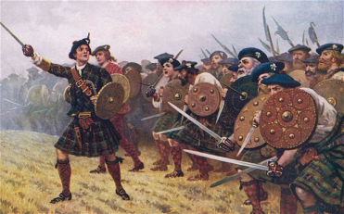
Act Four: Macduff requests an army
In England, Macduff tells Malcolm of how Scotland is suffering under the ‘tyrant’ Macbeth. Malcolm is suspicious of Macduff and tests his loyalty by saying that if Malcolm became king, his own ‘vices’ would be worse than Macbeth's.
Macduff excuses several of Malcolm’s flaws. However, when Malcolm claims that he will bring chaos on Scotland were he to rule, Macduff condemns him, saying his ‘hope ends here’.
Seeing Macduff’s response, Malcolm’s suspicions are gone and he tells Macduff that he was ‘false speaking’ and is in fact devoted to his country and people.
Malcolm is ready with Old Siward and 10,000 men to invade Scotland. A doctor tells how King Edward cures people through touch, which is a gift bestowed on true kings.
Ross arrives to tell Macduff the terrible news about the death of his wife and children. Malcolm comforts Macduff, advising that they ‘make us medicines of our great revenge to cure this deadly grief’.

Slide 70
What have I learned?
Secure the basics
What does Malcolm test about Macduff?
What does Malcolm say he would do to Scotland to test Macduff?
What does Malcolm conclude about Macduff?
Master the topic
Who is Malcolm going to invade Scotland with to take the throne from Macbeth?
What news does Ross bring Macduff?
How do they plan to use their feelings about the news?

Slide 71
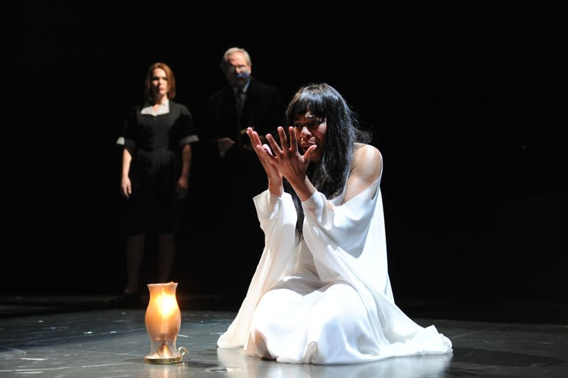
Act Five: Lady Macbeth suffers
A doctor and Lady Macduff’s gentlewoman watch Lady Macbeth sleepwalk. Her eyes are open but ‘their senses shut’. As she walks in, she rubs her hands and speaks in her sleep. She tries to wash a ‘damned spot’ of blood from her hands.
LADY MACBETH
Out, damned spot; out, I say.
One, two,—why, then ’tis time to do’t.
Hell is murky.
Fie, my lord, fie, a soldier and afeard?
What need we fear who knows it when none can call our power to account?
Yet who would have thought the old man to have had so much blood in him?
These words are spoken by Lady Macbeth in Act 5, scene 1, lines 30–34, as she sleepwalks through Macbeth’s castle on the eve of his battle against Macduff and Malcolm. Earlier in the play, she possessed a stronger resolve and sense of purpose than her husband and was the driving force behind their plot to kill Duncan.
When Macbeth believed his hand was irreversibly bloodstained earlier in the play, Lady Macbeth had told him, “A little water clears us of this deed” (2.2.65). Now, however, she too sees blood. She is completely undone by guilt and descends into madness.
It may be a reflection of her mental and emotional state that she is not speaking in verse; this is one of the few moments in the play when a major character—save for the witches, who speak in four-foot couplets—strays from iambic pentameter.

Slide 72
What have I learned?
Secure the basics
Who is watching over Lady Macbeth as she sleeps?
How does Lady Macbeth behave in her sleep?
Why does she behave this way?
Master the topic
What does Lady Macbeth see on her hands in her sleep? Why?
How does Lady Macbeth speak differently here?
Why might this be?

Slide 73
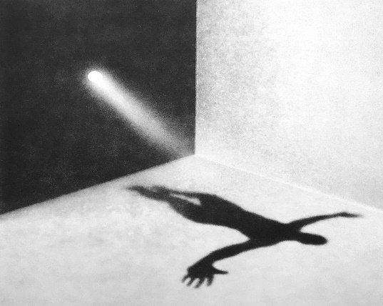
Act Five: Macbeth under attack
The thanes discuss how the English forces are approaching, led by Malcolm, Siward and Macduff. Macbeth is in Dunsinane but his men are rising up against him, some calling him mad. The group begin their march towards Birnam Wood.
Macbeth angrily dismisses those who bring him reports of attack. He reassures himself that he ‘cannot taint with fear’ because of the witches’ prophecies, but calls for his armour to be brought to him by a character called Seyton. The doctor tells Macbeth that he cannot help Lady Macbeth with the ‘thick-coming fancies that keep her from her rest’.
The Scottish lords gather with Malcolm, Macduff and their army. They cut down boughs of the trees in Birnam Wood to use as camouflage and ‘shadow the numbers of our host’.
Macbeth continues to stand his ground against the siege. He has ‘almost forgot the taste of fears’. Seyton reports that Lady Macbeth is dead. Macbeth reflects on the pointless nature of life being only ‘a tale told by an idiot, full of sound and fury, signifying nothing’.
MACBETH
Life’s but a walking shadow, a poor player
That struts and frets his hour upon the stage
And then is heard no more. It is a tale
Told by an idiot, full of sound and fury,
Signifying nothing.
A messenger informs Macbeth that he has seen Birnam Wood moving towards Dunsinane hill. Macbeth is unnerved that the prophecy has come true but vows he will die fighting.
Malcolm’s army have arrived outside the castle. They throw down their camouflaging branches to reveal themselves. Malcolm talks through the battle plan against the ‘tyrant’s power’.
Macbeth declares that he will fight, but remains reassured by the prophecy that he cannot be defeated by anyone born of a woman. Young Siward challenges Macbeth and Macbeth kills him. Macduff enters the castle, seeking vengeance on Macbeth for the murder of his family. Malcolm and Siward enter the castle.

Slide 74
What have I learned?
Secure the basics
Who is coming to Macbeth’s castle to attack him and where are they marching towards?
How do Macbeth’s own men feel about him at this point?
How do the army attacking Macbeth camouflage themselves as they close in on his castle?
What metaphor does Macbeth use to describe life?
Master the topic
Which of the witches’ prophecies does Macbeth realise has come true?
What does Malcolm continually refer to Macbeth as?
What prophecy is Macbeth sure will not come true?
Who does Macbeth kill when they enter his castle?

Slide 75
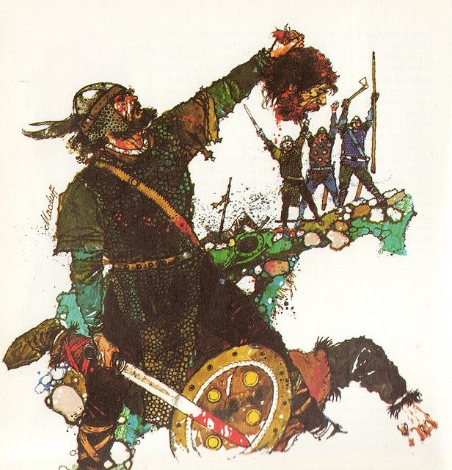
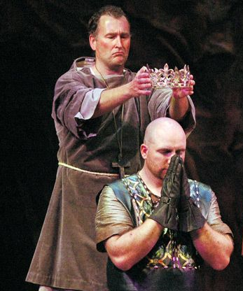
Act Five: Macbeth’s final stand
Macduff confronts the ‘hell-hound’ Macbeth and they fight.
When Macbeth claims he cannot be defeated because he has a ‘charmed life’, Macduff reveals that he was ‘from his mother’s womb untimely ripped’.
The witches’ prophecy comes true as Macduff kills Macbeth and ends his horrible reign.
Malcolm is concerned about the safety of Macduff and Young Siward. Ross tells Siward that his son has been killed in battle, but died bravely.
Macduff arrives with Macbeth’s severed head. He hails Malcolm the new King of Scotland.
Malcolm honours those who have fought alongside him against the tyranny of ‘this dead butcher and his fiend-like queen’. He invites them to see him crowned.

Slide 76
What have I learned?
Secure the basics
Who does Macbeth finally fight?
What reason does Macbeth give as to why he can’t be defeated?
What prophecy finally comes true?
What news does Ross deliver towards the end of the battle?
Master the topic
What does Macduff do with Macbeth’s body? Why do you think this is?
What does Malcolm call Macbeth and Lady Macbeth?
What title is Malcolm given?

Slide 77
Structure
Macbeth takes places in five acts. In the case of Macbeth, the structure is strictly chronological. This is where events are revealed to the audience/reader in the order in which they have happened. Sometimes events are described rather than shown (e.g. Macbeth becoming king). Others happen offstage (out of sight of the audience) for example, Duncan's murder.
The majority of the writing in Macbeth is in poetic form, though sometimes prose is used. The majority of the play is written in blank verse or iambic pentameter for most characters. The witches often speak in a four-beat-rhythm to separate them from other characters, and lower-class uneducated characters like the Porter speak in prose.
Act 3
Climax
Macbeth structure chart
Rising Action
Falling Action
Act 4
Exposition
Act 2
Denouement
Act 1
Act 5
Act 1 - Exposition: Main characters are introduced; the Witches make their predictions; thoughts of murder start to form.
Act 4 – Falling Action: Macbeth returns to the Witches; Macduff’s family is slaughtered; Malcolm and Macduff plan their invasion.
Act 2 – Rising Action: Macbeth keeps changing his mind; Lady Macbeth takes control; King Duncan’s murder (key moment).
Act 5: The invasion is carried out and Malcolm becomes King; the Witches' predictions come true in unexpected ways; both Macbeth and Lady Macbeth die.
Act 3 - Climax: Macbeth becomes King; Banquo is murdered and Fleance escapes; Macduff joins Malcolm in England.

Slide 78
What have I learned?
Secure the basics
What does chronological order mean?
In what different ways is the action of the play shown to the audience?
What poetic form is the play mostly written in?
What poetic form separates the witches speech from other characters?
Master the topic
What happens in the Exposition of the play?
What do we see during the Rising Action of the play?
What is the Climax of the play?
What happens during the Falling Action?
What happens in the Denouement?

