Slide 1
Questions in GCSE History
Give two things you can infer… (4 marks) Paper 3
Describe two features of… (4 marks) Paper 1, Paper 2
Explain one way… (4 marks) Paper 1
How would you follow up… (4 marks) Paper 1
How useful are sources … (8 marks) Paper 1, Paper 3
Explain the consequence.. (8 marks) Paper 2
Write a narrative account (8 marks) Paper 2
Study interpretations … they give different views…What is the main difference? (4 marks) Paper 3
Suggest one reason why interpretations are different… (4 marks) Paper 3
Explain why… (12 marks) Paper 1, Paper 2, Paper 3
How far do you agree with the statement? 16 marks Paper 1, Paper 2
How far do you agree with interpretation…(16+4 marks) Paper 3
Explain the importance… (8+8 marks) Paper 2

Slide 2
Give two things you can infer from the source(4 marks) Paper 1 and 3
Structure:
I can infer that:
Details in the source that tell me this:
I can infer that:
Details in the source that tell me this:

Slide 3
Give two things you can infer from source A about Guerrilla Tactics used in south Vietnam. (4 marks)
Source A : An interview by Tim O'Brien who served in the Vietnam War as an infantryman. He describes the dangers of going out on patrol.
The most feared mine was the Bouncing Betty. It was conical shaped, three prongs jutting out of the soil. When your foot hit the prong, a charge went off that shot the mine into the air, a yard high, showering shrapnel everywhere. It's a mine that goes after the lower torso: a terrible mine... On one occasion after my company had encamped and sent out patrols there was a large explosion only 200 yards away... We raced out there and only two men were living out of a patrol of eight or so. Just a mess. It was like a stew, full of meat and flesh and red tissue and white bone.
Structure:
What I can infer:
Guerrilla tactics were very fatal.
Details in the source that tell me this:
‘Just a mess, it was like a stew..’
Notes:
5 mins

Slide 4
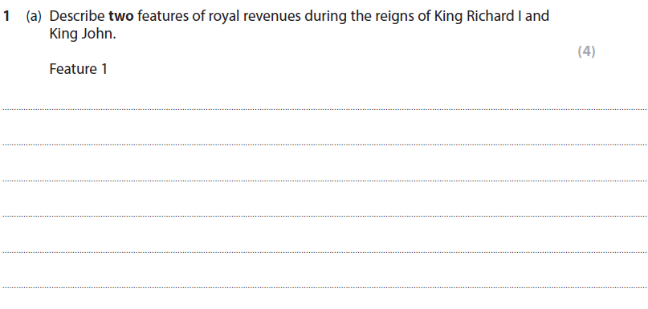
Describe two features of... (4 marks) Paper 2
Structure:
Point
Evidence x2
One feature of royal revenues was the scutage. Scutage was paid for the king to replace military service.
Notes:
5 mins

Slide 5


Explain one way..(4 marks) Paper 1
This a short answer question that
follows the below in a single, 1/3
page paragraph:
Say one way people were treated in the 13th Century about a particular type of treatment.
  Then give supporting details about that treatment.
Now say how people were now being treated in the 17th Century talking about the related treatment, and why.
  Then give supporting details about that treatment.
Explain one way in which ideas about the treatment of disease were different in the 17th century from the ideas in the 13th century. [4]
Exam Tip!
The difference between half marks and full marks on this question is how precise your knowledge is. Make sure you give a fact that relates to each time period.

Slide 6
Model answer.
One way in which ideas about the treatment of disease were different in the 17th century from the ideas in the 13th century was the different cures. Medieval medical treatments were mostly focused on balancing the humours, like purging, bleeding or trepanning the patient and also mixing herbal remedies.
However in the 17th century, scientists started to use chemical cures, Alchemy, or ‘medical chemistry’ had an impact on treatment. Inspired by Paracelsus, medical chemists experimented with metals to cure illness.
Point: Repeat question and make your point.
Evidence: Support with evidence.
Point: Make your second point.
Evidence: Support with evidence.

Slide 7
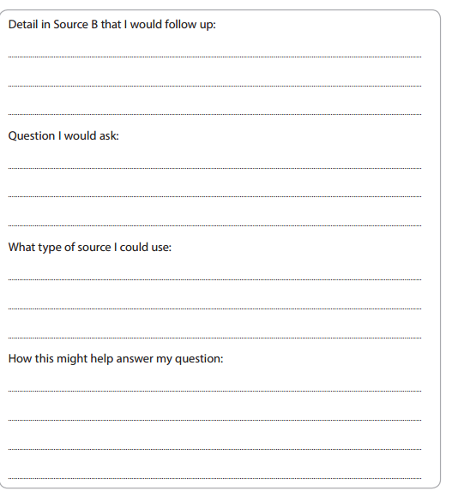
How would you follow up..(4 marks) Paper 1
Structure:
Detail: It needs to be a quote copied out of the source.
The question needs to relate to the source.
Use RAMC, FANY medical records as answer.
It would give me a better insight of the ….
Notes:
5 mins

Slide 8
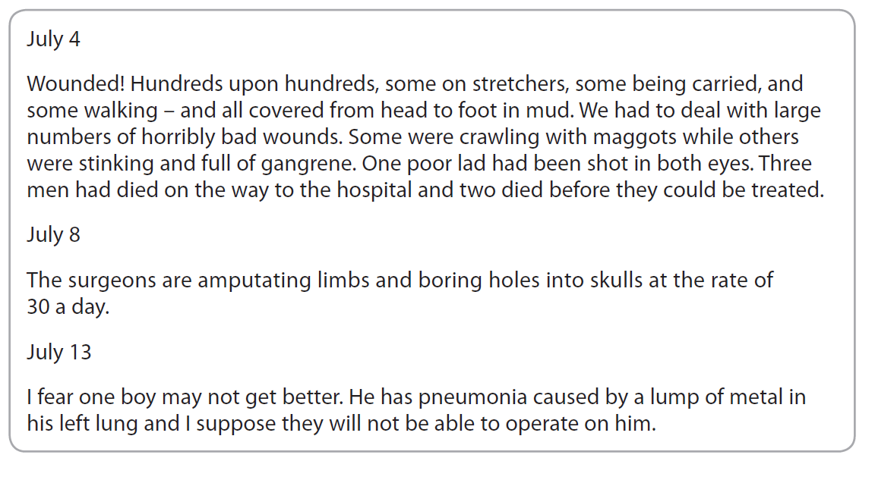
Detail:
‘The surgeons are amputating limbs’
Question:
What kind of anaesthetic did they use?
Source:
RAMC Medical record
Help:
It would give me a better insight of the every day routine of surgeons on the Western Front.

Slide 9
How useful are sources … (8 marks) Paper 1 and 3
Source A | Source B
What does source A say about …? What quotes/details could you use? What knowledge do you have which supports this? Look at the provenance – what makes the source useful? | What does source B say about …? What quotes/details could you use? What knowledge do you have which supports this? Look at the provenance – what makes the source useful?
Notes:
5 mins

Slide 10
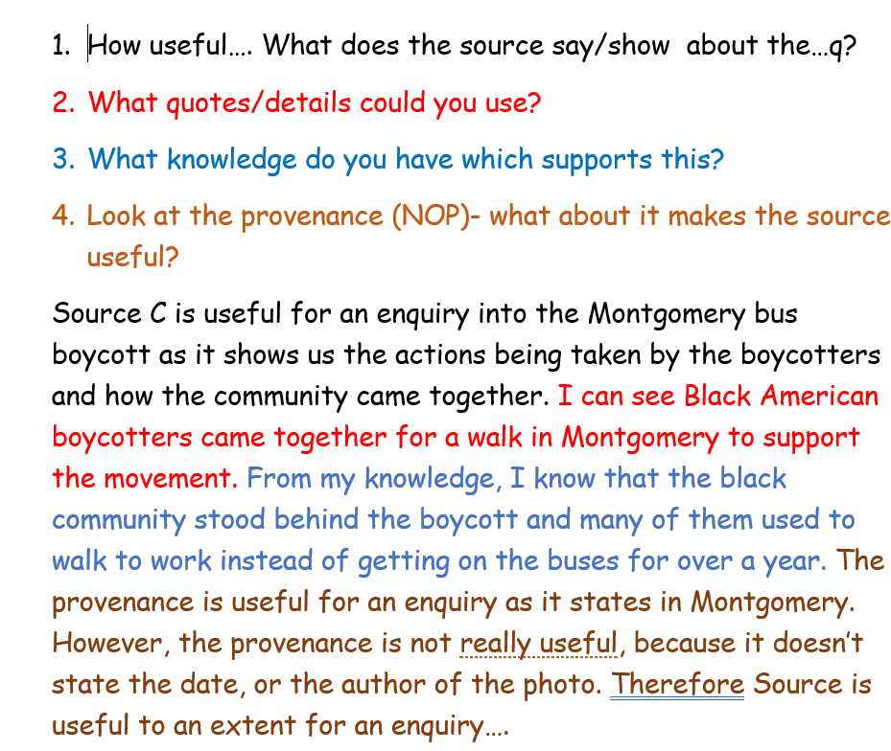
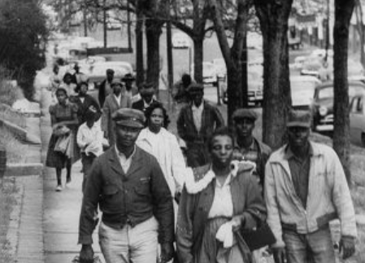

Slide 11
Explain two consequences of… (8 marks) Paper 2
Structure
Two paragraphs – one for each consequence.
You must say what the consequence was and then EXPLAIN the impact and difference it made.#
POINT. One consequence was…
EVIDENCE. For example…
EXPLAIN. This led to/resulted in….
LINK. Therefore, …. Was one consequence..

Slide 12
Explain two consequences of the 1849 Gold rush in California [8]
One consequence of the 1849 Gold Rush was the increased population in California. For example, the population increased from 8,000 in 1846 to over 120,000 in 1851 due to the mass migration and mass settlement of the gold prospectors. This resulted in far bigger mining communities which then meant problems such as drunken violence and prostitution taking place. This was a huge change from the small communities it had before gold was discovered. Therefore, increased population was one consequence of the Gold Rush in California.
A second consequence of the 1849 gold rush was the mix of cultures and the ethnic mix of so many people. For example, an famine in China led to a huge increase in Chinese migrants. By 1852, there were 20,000 Chinese prospectors and many arrived in San Francisco expecting work. Unfortunately, this led to discrimination where Chinese prospectors were given older claimed land. As a consequence, they worked hard but were then robbed and even murdered by white miners. The effect of this was further tension between the various ethnic communities in the West. Therefore, mix of cultures was one consequence of the Gold Rush in California.
This led to…
This meant that…..
As a result of…
This changed…..
The effect of this was….
As a consequence….

Slide 13
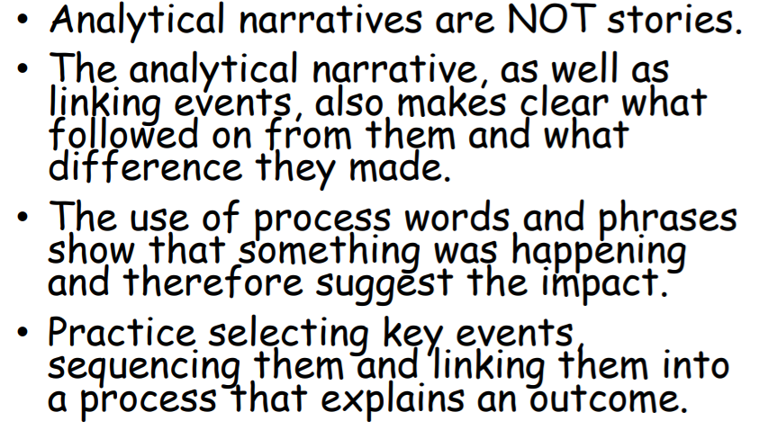
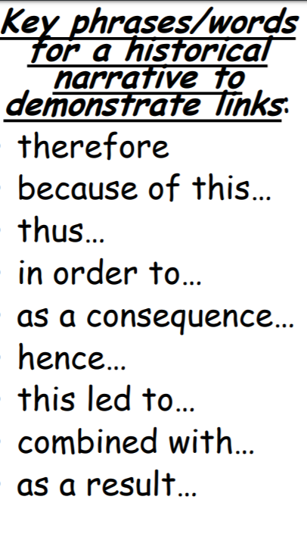
Write a narrative account of… (8 marks) Paper 2
Write a narrative account analysing…
KEY SKILLS:
Explain how one event led to another.
Do this in a logical chronological order.
Always remember to add a point of your own.
Always link back to the question.
Refer back to the question at the end.
Use specific knowledge (see separate box)
Structure

Slide 14
Write a narrative account analysing the events of the Indian Wars 1862 1868
Indian wars happened between 1862 and 1868 as the result of conflicts between white American settlers and Plains Indians.
Little Crow was a chief of a band of the Dakota Sioux in Minnesota. In 1851 they agreed to move to two reservations. However, these were small, the government promised supplies and money to ensure the tribe’s safety. The government refused to pay because the Sioux Indians owed money to traders. White settlers also began to take pieces land that were good for farming. As a result, the Dakota Sioux gave up half their reservation for money to pay their debts. As a consequence, by 1862 Dakota Sioux had no food for money and people tried to survive by eating grass.
As a result of this, Little Crow attacked warehouses and shared the food amongst the starving people. They also killed around 600 settlers and US soldiers. Then, the US army arrived and executed 38 warriors, Little Crow fled into Dakota, where he was shot dead for reward money. The rest of Dakota Sioux were forced to move to an other reservation, where they starved to death during the winter.

Slide 15
Explain why.. (12 marks) Paper 1, 2 and 3
Exam practice
Explain why there were improvements in medical knowledge in the years c1500-c1700. You may use the following in your answer:
Vesalius
The printing press
You must also use information of your own.
Point 3: Thomas Sydenham, William Harvey, Royal Society, humanism.

Slide 16
One of the reasons that there were improvements in medical knowledge in the years c1500-c1700 is Vesalius. Vesalius studied medicine and became a lecturer in surgery. He published his main work ,The Fabric of Human Body’ in 1543, after he had been able to carry out dissection on humans. It was a revolutionary work and he noted Galen made errors in his theory on human body, he found 300 mistakes all together in Galen’s work. Vesalius also encouraged other doctors to carry out dissections and base their work on that. Eventually Vesalius’ work laid foundations for future discoveries, e.g. Harvey and blood circulation. His contribution to medicine made the study of anatomy become the central part of medicine. Therefore, Vesalius is one of the reasons there were improvements in medical knowledge in the years c1500-c1700.
P
E
E
L

Slide 17
Study interpretations … they give different views…What is the main difference? Paper 3
Acknowledge that they both talk about the same issue but having a different opinion.
Sentence starters:
A main difference between interpretation 1 and 2 is…
Interpretation 1 says … It can be supported by the quote..
Interpretation 2 says… It can be supported by the quote..

Slide 18
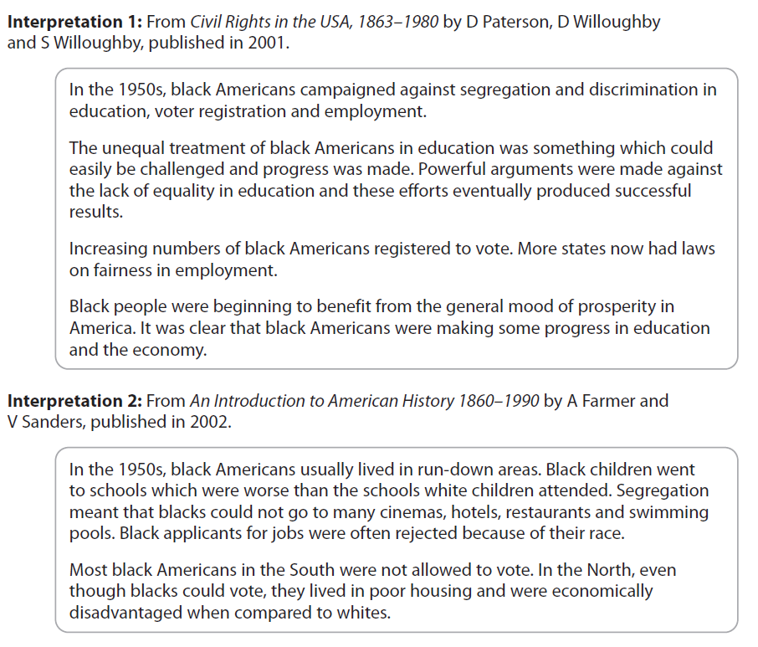
Study interpretations … they give different views…What is the main difference? Paper 3
The main difference between interpretations 1 and 2 that they give different opinions on position of Black Americans in the 1950s.
Interpretation 1 states the Black people were in a good, developing position in the society. It can be supported by the quote: Increasing numbers of black Americans registered to vote.
On the other hand, Interpretation 2 states that Black Americans had a very bad experience throughout the 1950s. It can be supported by the quote: Black applicants for jobs were often rejected because of their race.

Slide 19
Suggest one reason why interpretations are different… (4 marks)
Paper 3
Has the historian given weight to different sources?
We always focus on this when we answer this question!
You must match the sources with the Interpretations.
Sentence starters:
The interpretations may differ because…
For example, source ..
This supports interpretation _ because…
Source _ supports interpretation _ because…

Slide 20
Suggest one reason why interpretations are different… (4 marks)
Paper 3
Interpretations 1 and 2 are different because the authors given weight to different sources.
Interpretation 1 can be supported by Source B , I can see Black people live in a ghetto among bad circumstances. This supports Interpretation 1.
However, Interpretation 2 could be based on Source B, as it states: during the graduation ceremony 61 black students marched together an it clearly supports Interpretation B.

Slide 21
How far do you agree with interpretation…(16+4 marks)
Paper 3
Paragraph 1: State the view given in interpretation 1 using evidence from the interpretation.
Agree/disagree with the view given in Interpretation 1 by using your own knowledge. (You need at least 2 pieces of evidence)
Paragraph 2: Disagree/agree with the view using details from Interpretation 1.
Agree/disagree with interpretation 2 by using your own knowledge. (You need at least 2 pieces of evidence)
Paragraph 3: You need to make a final judgement. Give a view on Interpretation 2.

Slide 22
How far do you agree with interpretation…(16+4 marks)
Paper 3
Interpretation 1 puts forward a view which states that the position of Black people got better during the 1950s. I do agree with Interpretation 1 to an extent as in some ways the position of Black people got better in the 1950s.
I can support this with the quote: ’Increasing numbers of black Americans registered to vote.’ There were more Black people eligible to vote and they had a better chance to represent themselves during elections. Additionally, I also agree with the statements. More and more black people attended schools, and many black Americans attended Universities. ‘Americans were making some progress in education..’. I can further support this from my knowledge as ….
Therefore I agree with Interpretation 1 to an extent about..

Slide 23
How far do you agree with the statement? 16 marks Paper 1, Paper 2
There was little progress in medicine in Britain during the Renaissance period c.1500—1700’ How far do you agree with the statement? Explain your answer. (16 marks)
Old ideas
Great Plague
You must also use information on your own.
Introduction - Optional for Grades 7-9
Paragraph 1: Given in the first bullet point: Old ideas.
Paragraph 2: Given in the second bullet point: Great Plague.
Paragraph 3: You have to choose a topic what disagrees with the argument: For example:
Thomas Sydenham, Vesalius..
Conclusion - Optional for Grades 7-9
Notes:
5 mins

Slide 24
There was little progress in medicine in Britain during the Renaissance period c.1500—1700’ How far do you agree with the statement? Explain your answer. (16 marks)
Old ideas
Great Plague
You must also use information on your own.

Slide 25
“There was little progress in understanding the cause of disease in the years 1500-1700”.
(Old ideas, Great Plague)
(16 marks)
I both agree and disagree with the statement reading “there was little progress in understanding the cause of disease in the years 1500-1700”. On one hand, the continuity in ideas of the cause of the Great Plague and the ideas of individuals such as Hippocrates and Galen, however there were also some developments such as the influence of the individual Sydenham, the invention of the printing press and the formation of the Royal Society.
I agree with the statement that there was a little progress in understanding the cause of disease in the years 1500-1700. During the Medieval period of 1250-1500, Hippocrates theorised the idea of the body containing Four Humours (black bile, yellow bile, phlegm and blood). Hippocrates suggested that an imbalance of one of these substances was what caused disease and illness and believed that an equal balance of the humours led to good health. Galen extended the Theory of the Four Humours by suggesting the humours should be replaced by the Theory of Opposites. Galen also believed in the idea of the soul, which fit with the teaching of the church. Even though The Four Humours was questioned during Renaissance, it was still used by ordinary people in Britain. Although this would be a logical explanation to disease, it was incorrect and only contributed to the continuity of ideas about the cause of disease, especially that treatment were still based on the Four Humours, like bloodletting, cupping, purging. Society also believed in miasma which was the belief that bad air and smells contained poisonous fumes that caused disease and illness and it stayed as the main idea for cause of disease in the years 1500-1700. Therefore, I agree with the statement that there was a little progress in understanding the cause of disease in the years 1500-1700.

Slide 26
Furthermore, I also agree with the statement as the Great Plague of 1665 also offered little progress about the cause of disease. Society believed the Great Plague was a result of astrology (the alignment of the stars), punishment from God, and continued to believe in an imbalance of the Four Humours. Again, this offered little progress in understanding the cause of disease during the period 1500-1700 as none of these hypothesis were true. Some members of society believed the disease was caused by touch, as infections patients could pass on their disease to others. This was actually true, so infectious patients were inoculated, and a cross was painted on their door to symbolise that someone had been affected by the plague and that others should steer clear of them. People believed in transference, which was the hypothesis that if one affected by the plague was to rub a chicken on their skin, the plague would pass onto the chicken and the patient would recover. Unsurprisingly however, this did not work, and again added continuity to the understanding of the cause of disease as society continued to believe that the Great Plague was sent from God. Therefore, I agree with the statement that there was a little progress in understanding the cause of disease in the years 1500-1700.

Slide 27
However, some progress made by the individual Sydenham, an important individual in moving medicine away from Hippocrates and Galen and theorising ideas about the cause and symptoms of diseases. Sydenham believed closely in recording symptoms and treatments intricately, rather than relying on ancient medical books which meant that he could interpret common causes of disease. Sydenham published his findings in “Observation Medicare” which emphasises the importance of dissection and observing symptoms to find the cause of disease. The invention of the printing press enabled medical information to spread further and contributed to the decline in influence of the church, meaning physicians could publish books that criticised Galen and promote scientific fact, rather than the teachings of the church which played a huge role in society during 1250-1700. The church controlled education (meaning the word of the church and God was taken as fact) and also had a large influence on books, which were hand written by monks, meaning only religious messages were promoted until the revolutionary invention of the printing press. This meant that the scientific causes of disease were difficult to discover as scientists were limited by the church’s teachings. Furthermore, Charles II founded the Royal Society in 1660 which became important in the development of new medicines and developing a better understanding of the cause of disease. It meant physicians could study one another’s work and offer sponsorships into the development of new medicines and research into the cause of disease. It shows there was a progress in in understanding the cause of disease in the years 1500-1700.
Therefore, I can conclude that there was little understanding about the cause of disease towards the beginning of the period 1500-1700 because of the continuity in the ideas of Hippocrates and Galen and the oppressive influence of the church. However, I agree that there was some progress into understanding the cause of disease because of the influence of the individual Sydenham, whose ideas about the cause of disease were assisted in being promoted by the invention of the printing press and the Royal Society.

Slide 28
Explain two importance of… (8+8 marks) Paper 2
Structure
Two paragraphs – PEEL
P. One importance of…Firstly, one important factor was…… The … was important because…
E. For example… (what did it do? Add knowledge and facts here)
E. Explain its importance? Why was it important?
What made it so important? Explain this clearly.
L. Link back to the statement.

Slide 29
GCSE exam question practice
Explain the importance of preparation in migration west (8 marks)
Explain the importance of preparation in migration west (8 marks)
It was important to take supplies to last for the 3,200 mile journey. This would include…..
It was important to set off in April because …….
It was important to travel in wagon trails of 20 or more because……
It was important to use explorers, mountain men or Indians as guides because…….
It was important not to try any short cuts on the Oregon trail such as the Donner Party. This was because….
Notes:
A lot of this information is in my L7 of the course – The Gold Rush and the Donner Party

